Slide 1
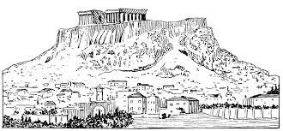
Acropolis
The acropolis the highest point in a Greek city state. There were important buildings there like temples.
Athena’s temple, the Parthenon, stood on the acropolis in Athens.

Slide 2
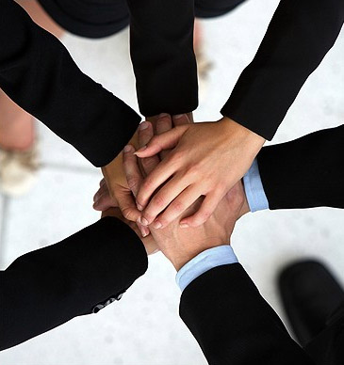
Alliance
An alliance is when two cities, armies, or people agree to work or even fight together, on the same side.
The Athenians and the Spartans formed an alliance to defeat the Persians.

Slide 3
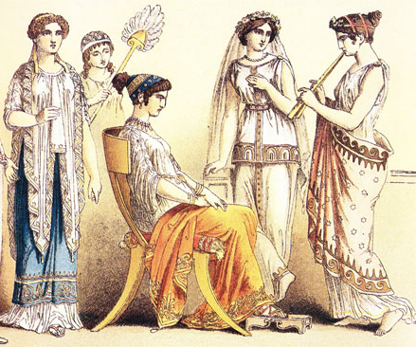
Aristocrats
Rich land owners who have lots of political power.
In ancient Athens before there was a democracy the aristocrats ran the government.

Slide 4
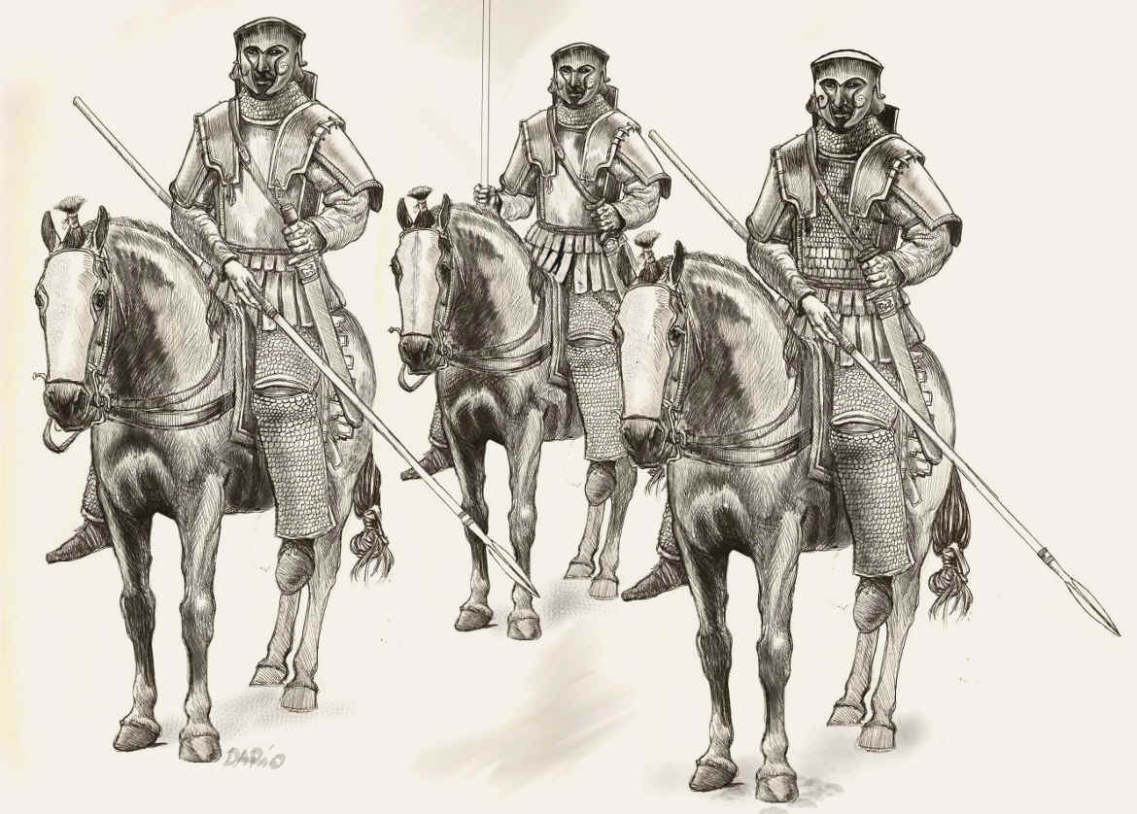
Cavalry
Soldiers in an army who rode horses.
The Persians made a mistake when they sent their cavalry to Athens
at the battle of
Marathon.

Slide 5
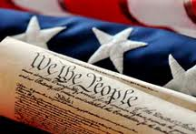
Democracy
Democracy is a kind of government in which citizens make and vote on laws.
In the United States we have a representative democracy, but ancient Greece had a direct democracy.

Slide 6
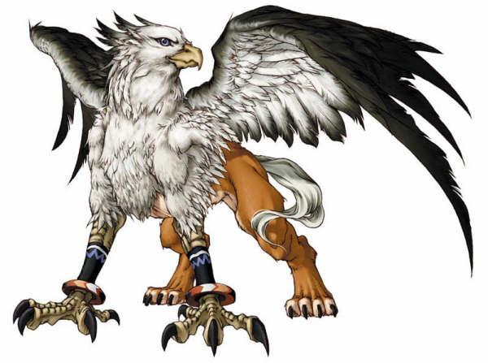
Mythology
Mythology is stories Greeks told about gods and heroes that try to explain the mysteries of the world.
Rick Riordan writes
books about the 21st
century that include
Characters from
Greek mythology.

Slide 7
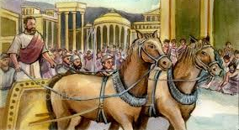
Oligarchy
A type of government in which a small group has rule or power.
Before Greece was a democracy it was an oligarchy ruled by aristocrats.

Slide 8
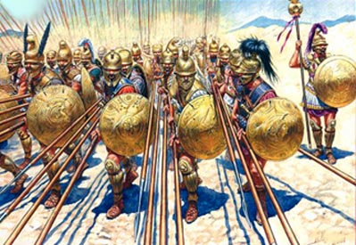
Phalanx
A phalanx is a group of soldiers standing side by side in an array with overlapping shields.
The Greeks used the phalanx to defeat the Persians at the battle of Marathon.

Slide 9
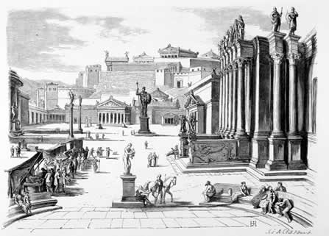
Polis
Polis is the Greek word for city-state. A polis is like a town with its own government.
Sparta was the most famous Greek Polis.

Slide 10
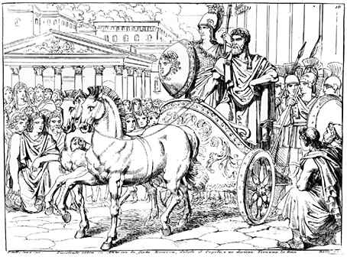
Tyrant
A tyrant is a kind of ruler that has all the power and the support of the military.
Peisistratus was a good tyrant in Greece that had to support of the people and the military.

