Slide 1
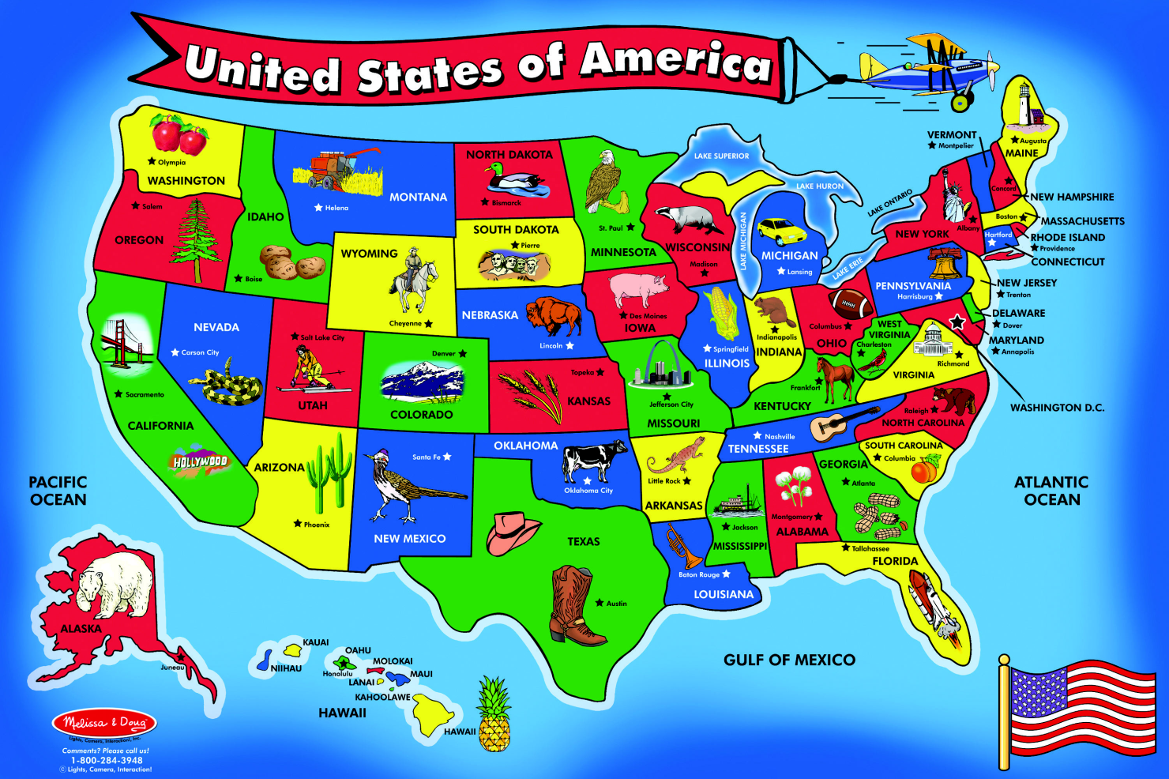
States and Regions
Of the country the United States
This image is an actual floor puzzle made by

Slide 2
Lesson Objectives
Identify the United States as a nation in North America.
Identify the different geographic, economic, and cultural characteristics of each region.
Describe the relative location of the five regions of the United States.

Slide 3
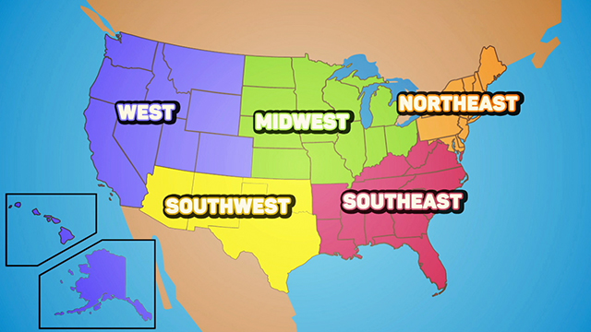
Regions of the United States

Slide 4
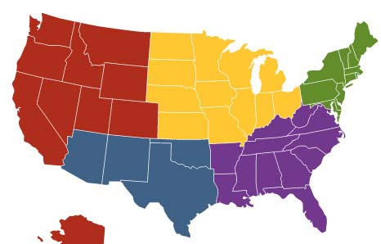
The Southwest
The Southwest Region is made up of the following states:
Northeast
West
Midwest
Oklahoma
Arizona
New Mexico
Southeast
SOUTHWEST
Texas

Slide 5
Geography of the Southwest
The Southwest Region includes the Rocky Mountains, the Sonoran Desert, the Great Plains, the Grand Canyon, the Gulf of Mexico, and the Rio Grande River.
Most people think of the Southwest as a dry and desert place with very flat land, but not enough water for farming.

Slide 6
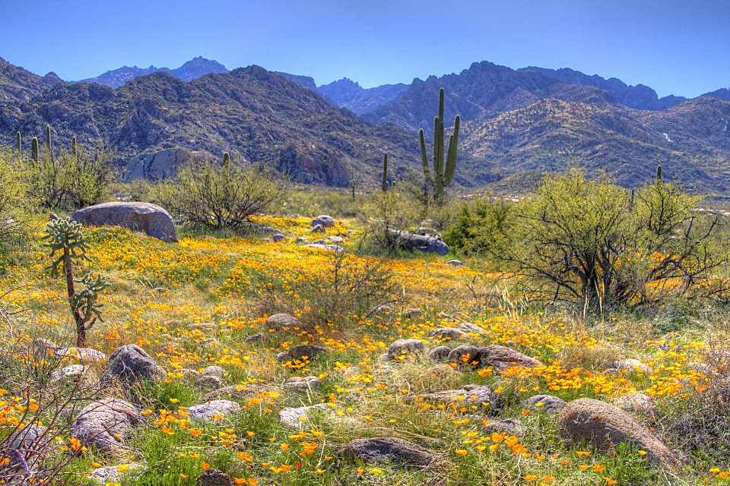
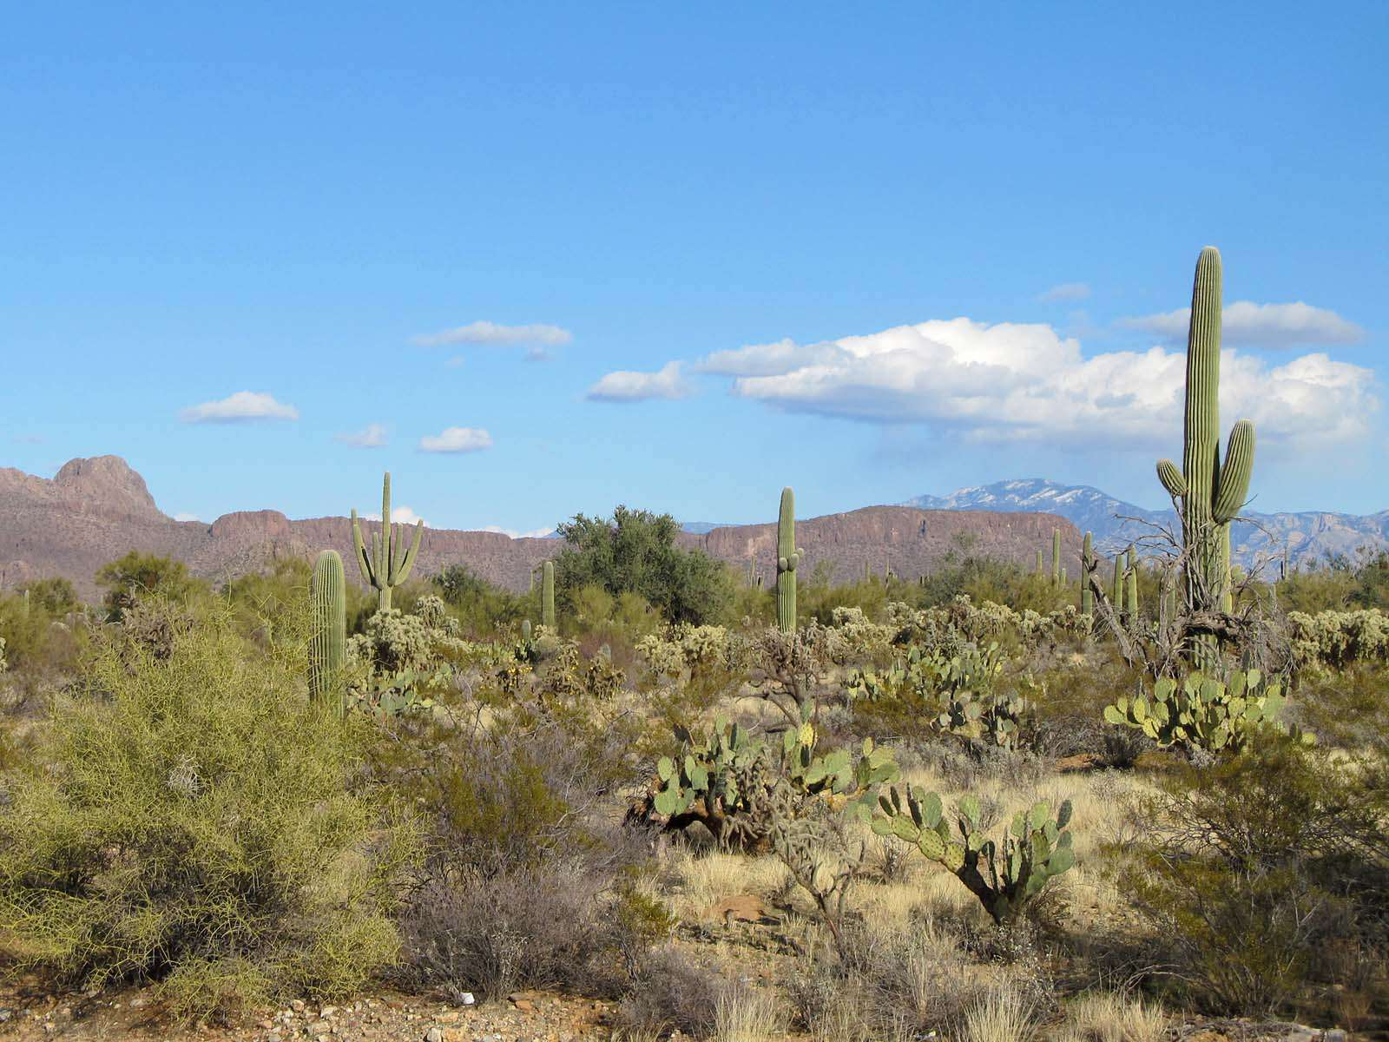
Geography of The Southwest
Sonoran Desert
Arizona

Slide 7
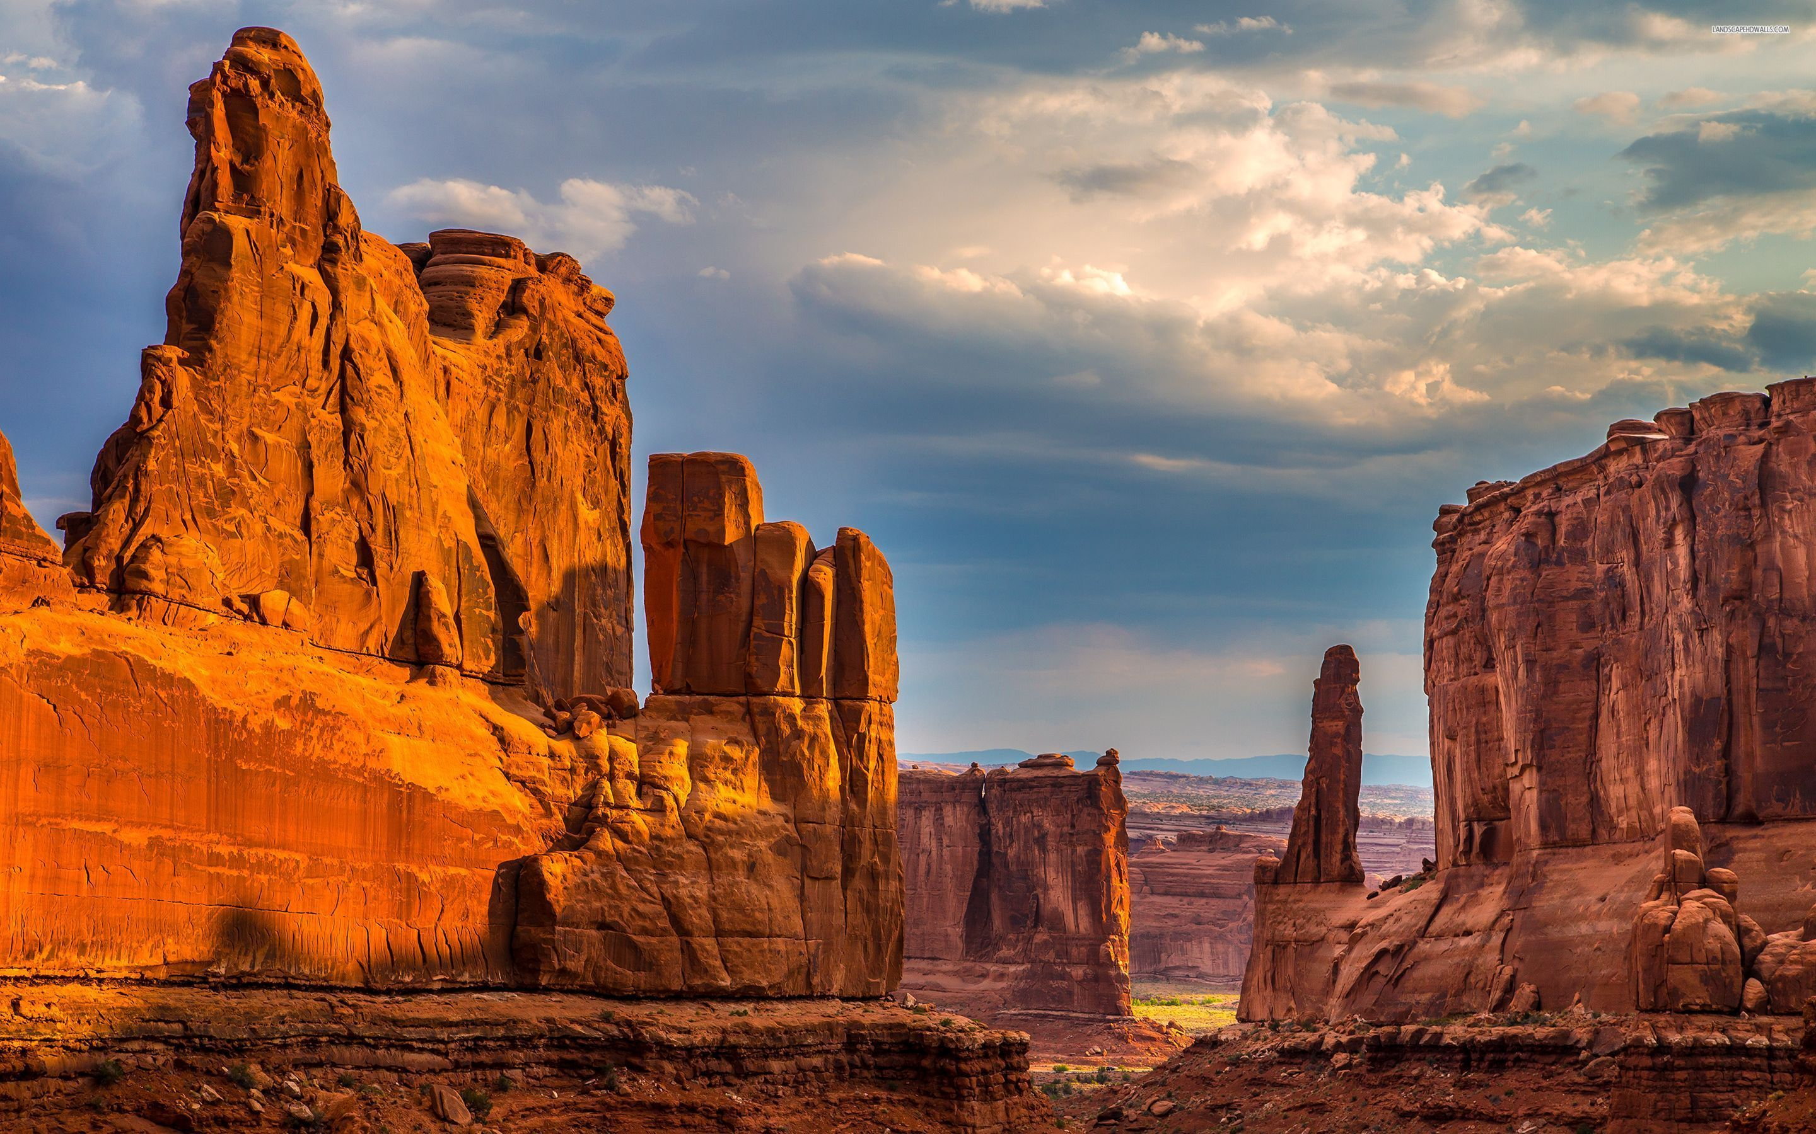
Geography of The Southwest
Grand Canyon
Arizona

Slide 8
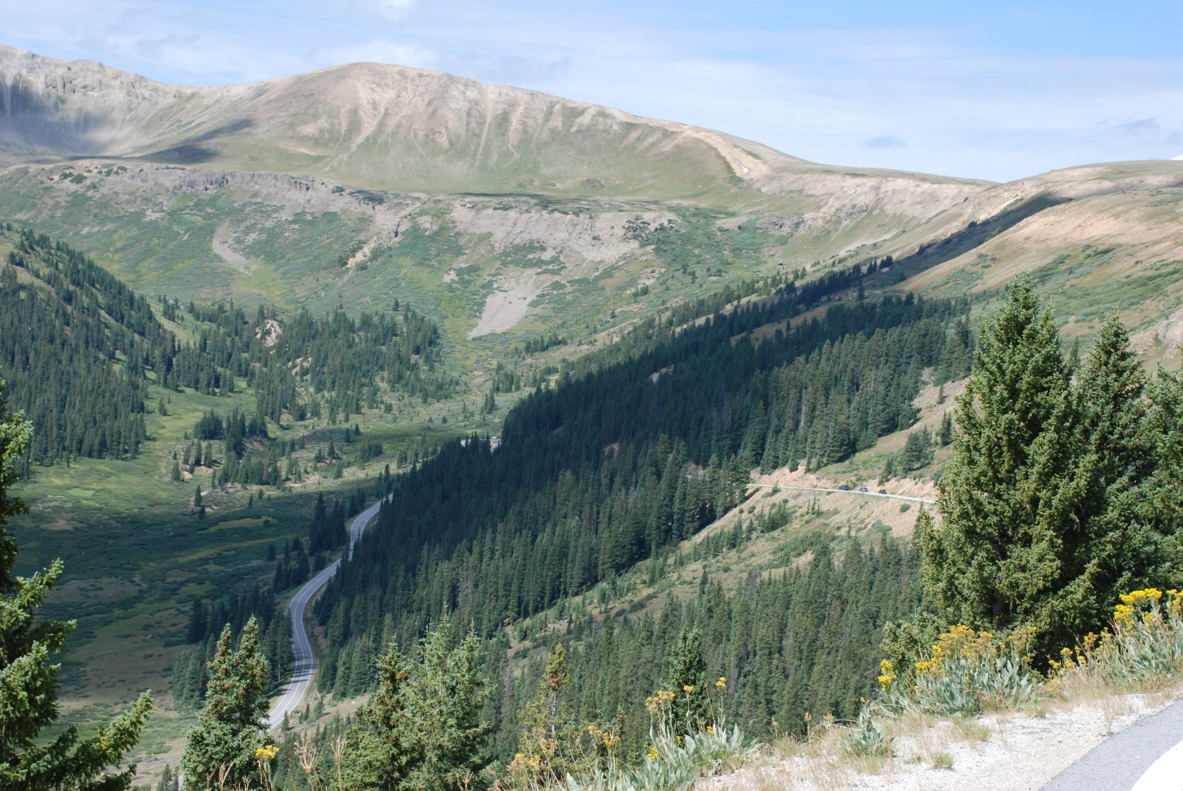
Geography of The Southwest
Rocky Mountains
New Mexico

Slide 9
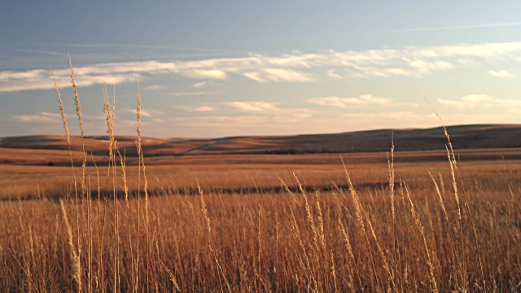
Geography of The Southwest
Great Plains
Oklahoma

Slide 10
Geography of The Southwest
Gulf of Mexico
Texas

Slide 11
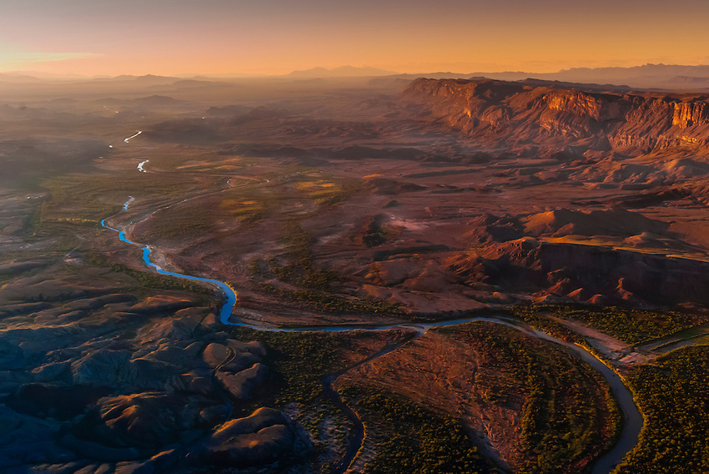
Geography of The Southwest
Rio Grande River
Texas and New Mexico

Slide 12
Economy of the Southwest
The Southwest builds their economy (making money) from:
industry (making things like cars or computers),
ranching (raising cattle),
Petroleum (oil)
and tourism.
The population of the Southwest is about 34 million people.

Slide 13
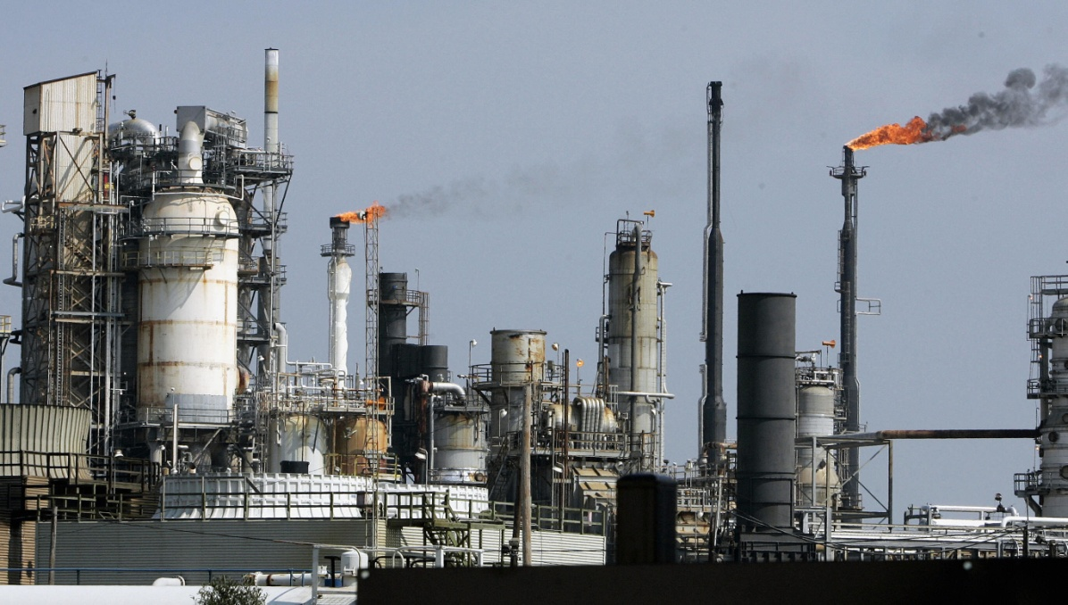
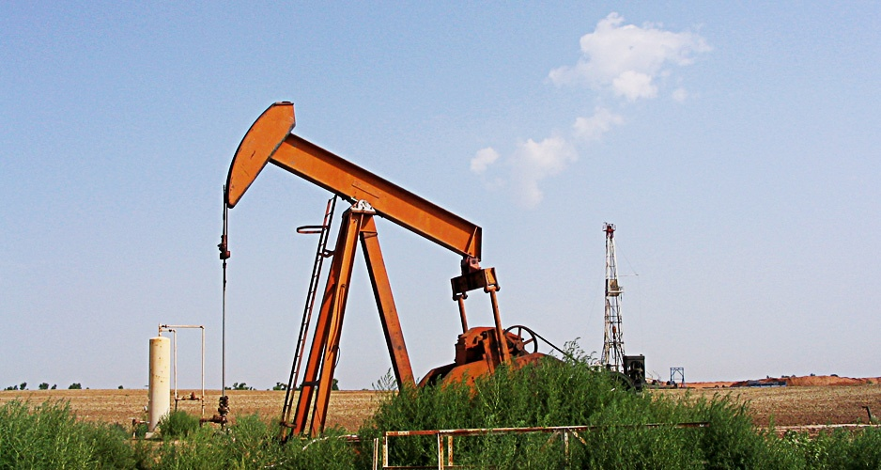
Industry of The Southwest
Oil refinery in Texas
Drilling for oil in Oklahoma

Slide 14
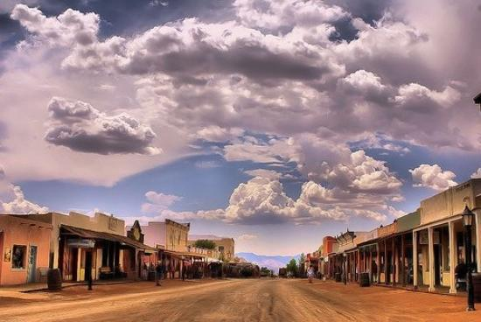
Tourism of The Southwest
Tombstone, Arizona. It’s like the Walk Back in Time every day. This town preserves the ways of the “old west”.
Tombstone Morgan’s personal video about Tombstone.

Slide 15
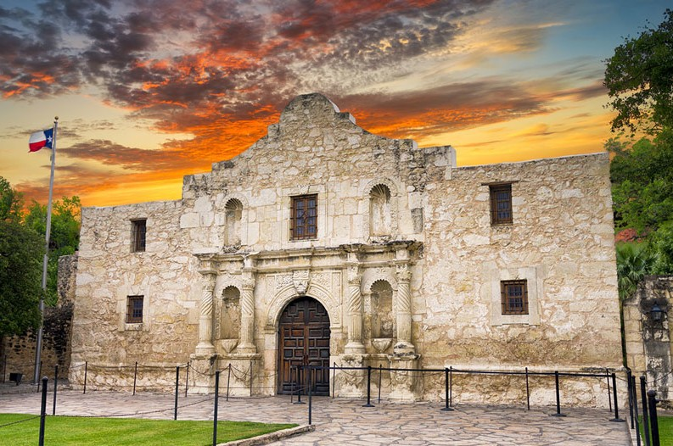
Tourism of The Southwest
The Alamo in San Antonio, Texas. This event was very important to the formation of Texas.

Slide 16
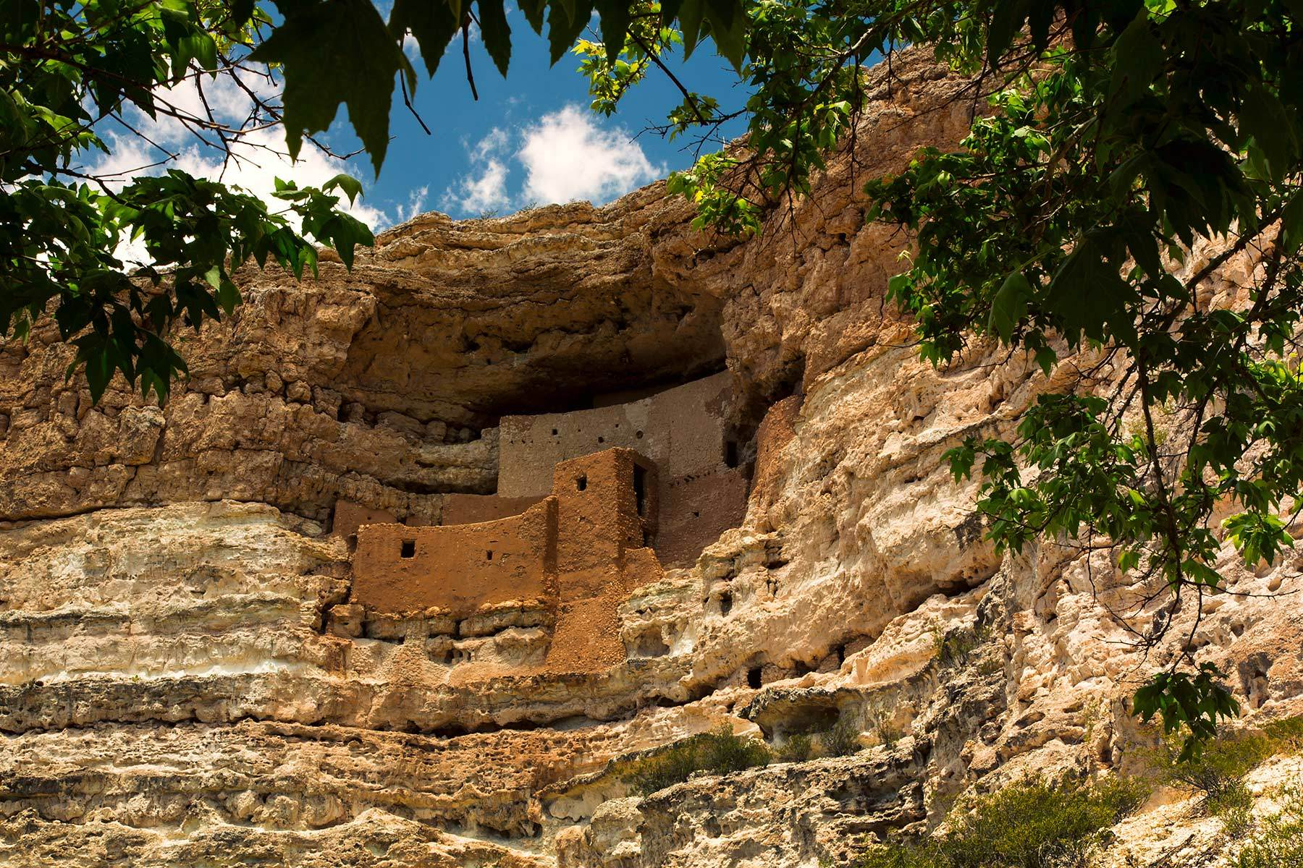
Tourism of The Southwest
Montezuma Castle cliff dwelling in Arizona. This housing was built by native Americans and was built 100 feet from the canyon floor. Here is a video about a similar dwelling in New Mexico.

Slide 17
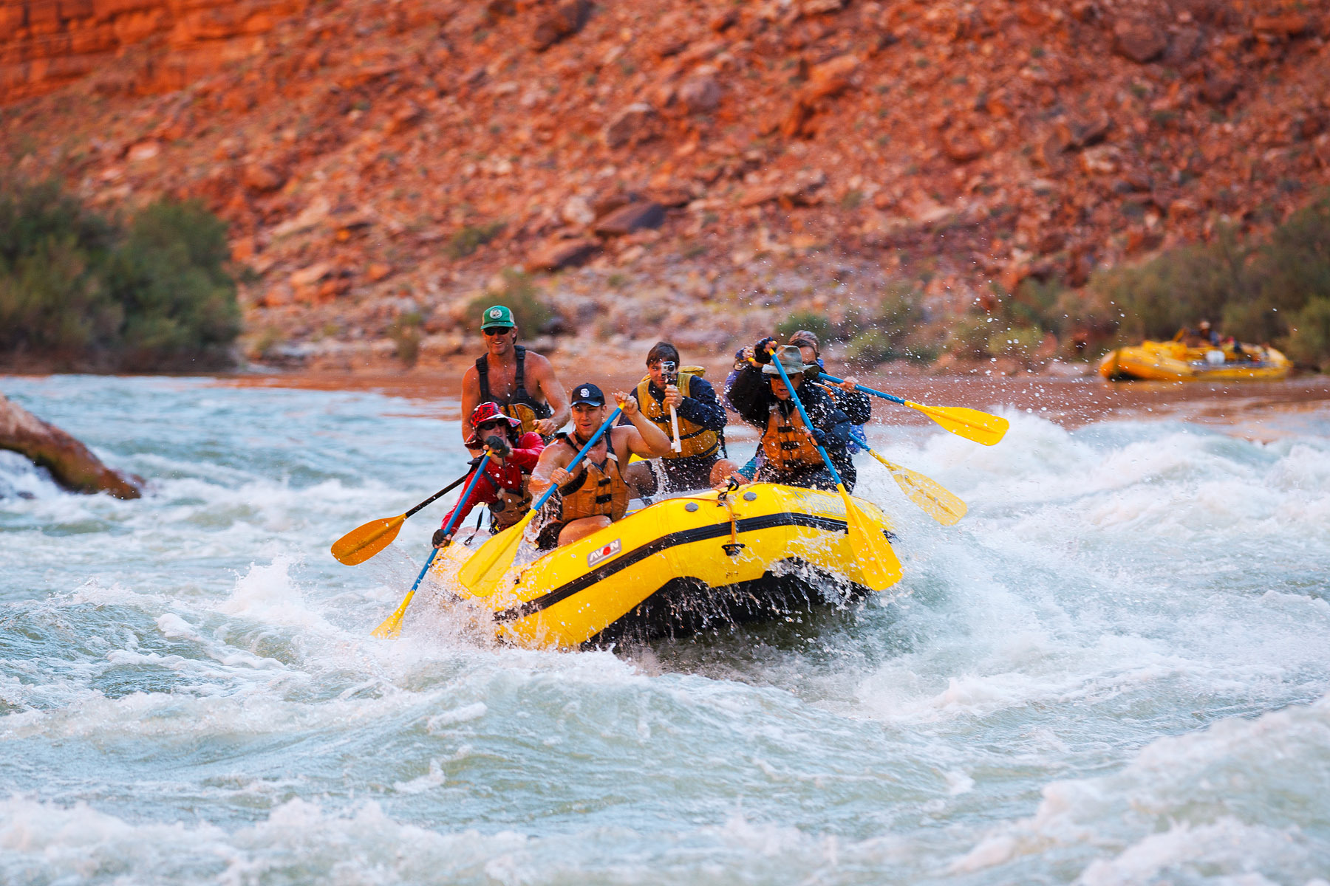
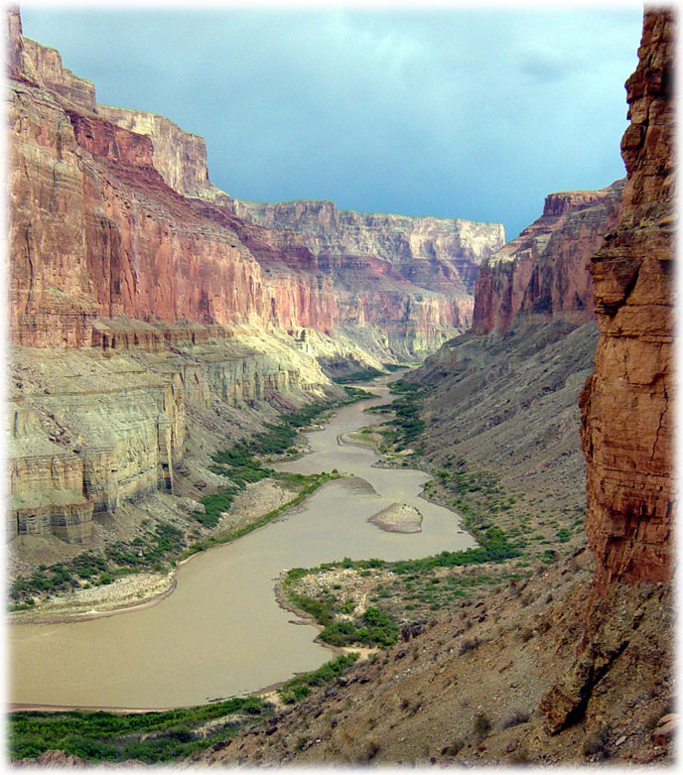
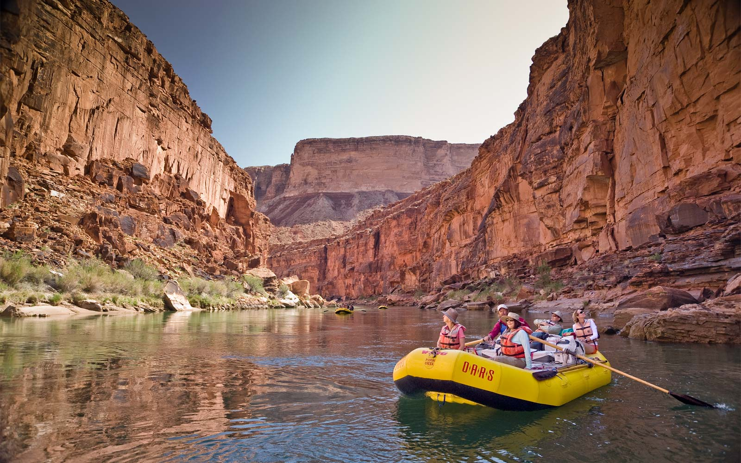
Tourism of The Southwest
The Grand Canyon national park in Arizona. People hike, camp, and raft through the canyon.

Slide 18
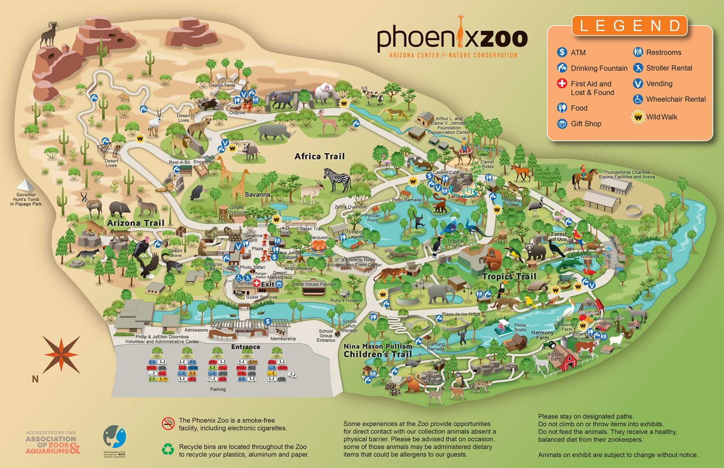
Tourism of The Southwest
The Phoenix Zoo in Phoenix, Arizona. Notice that there is an Arizona trail with native wildlife.

Slide 19
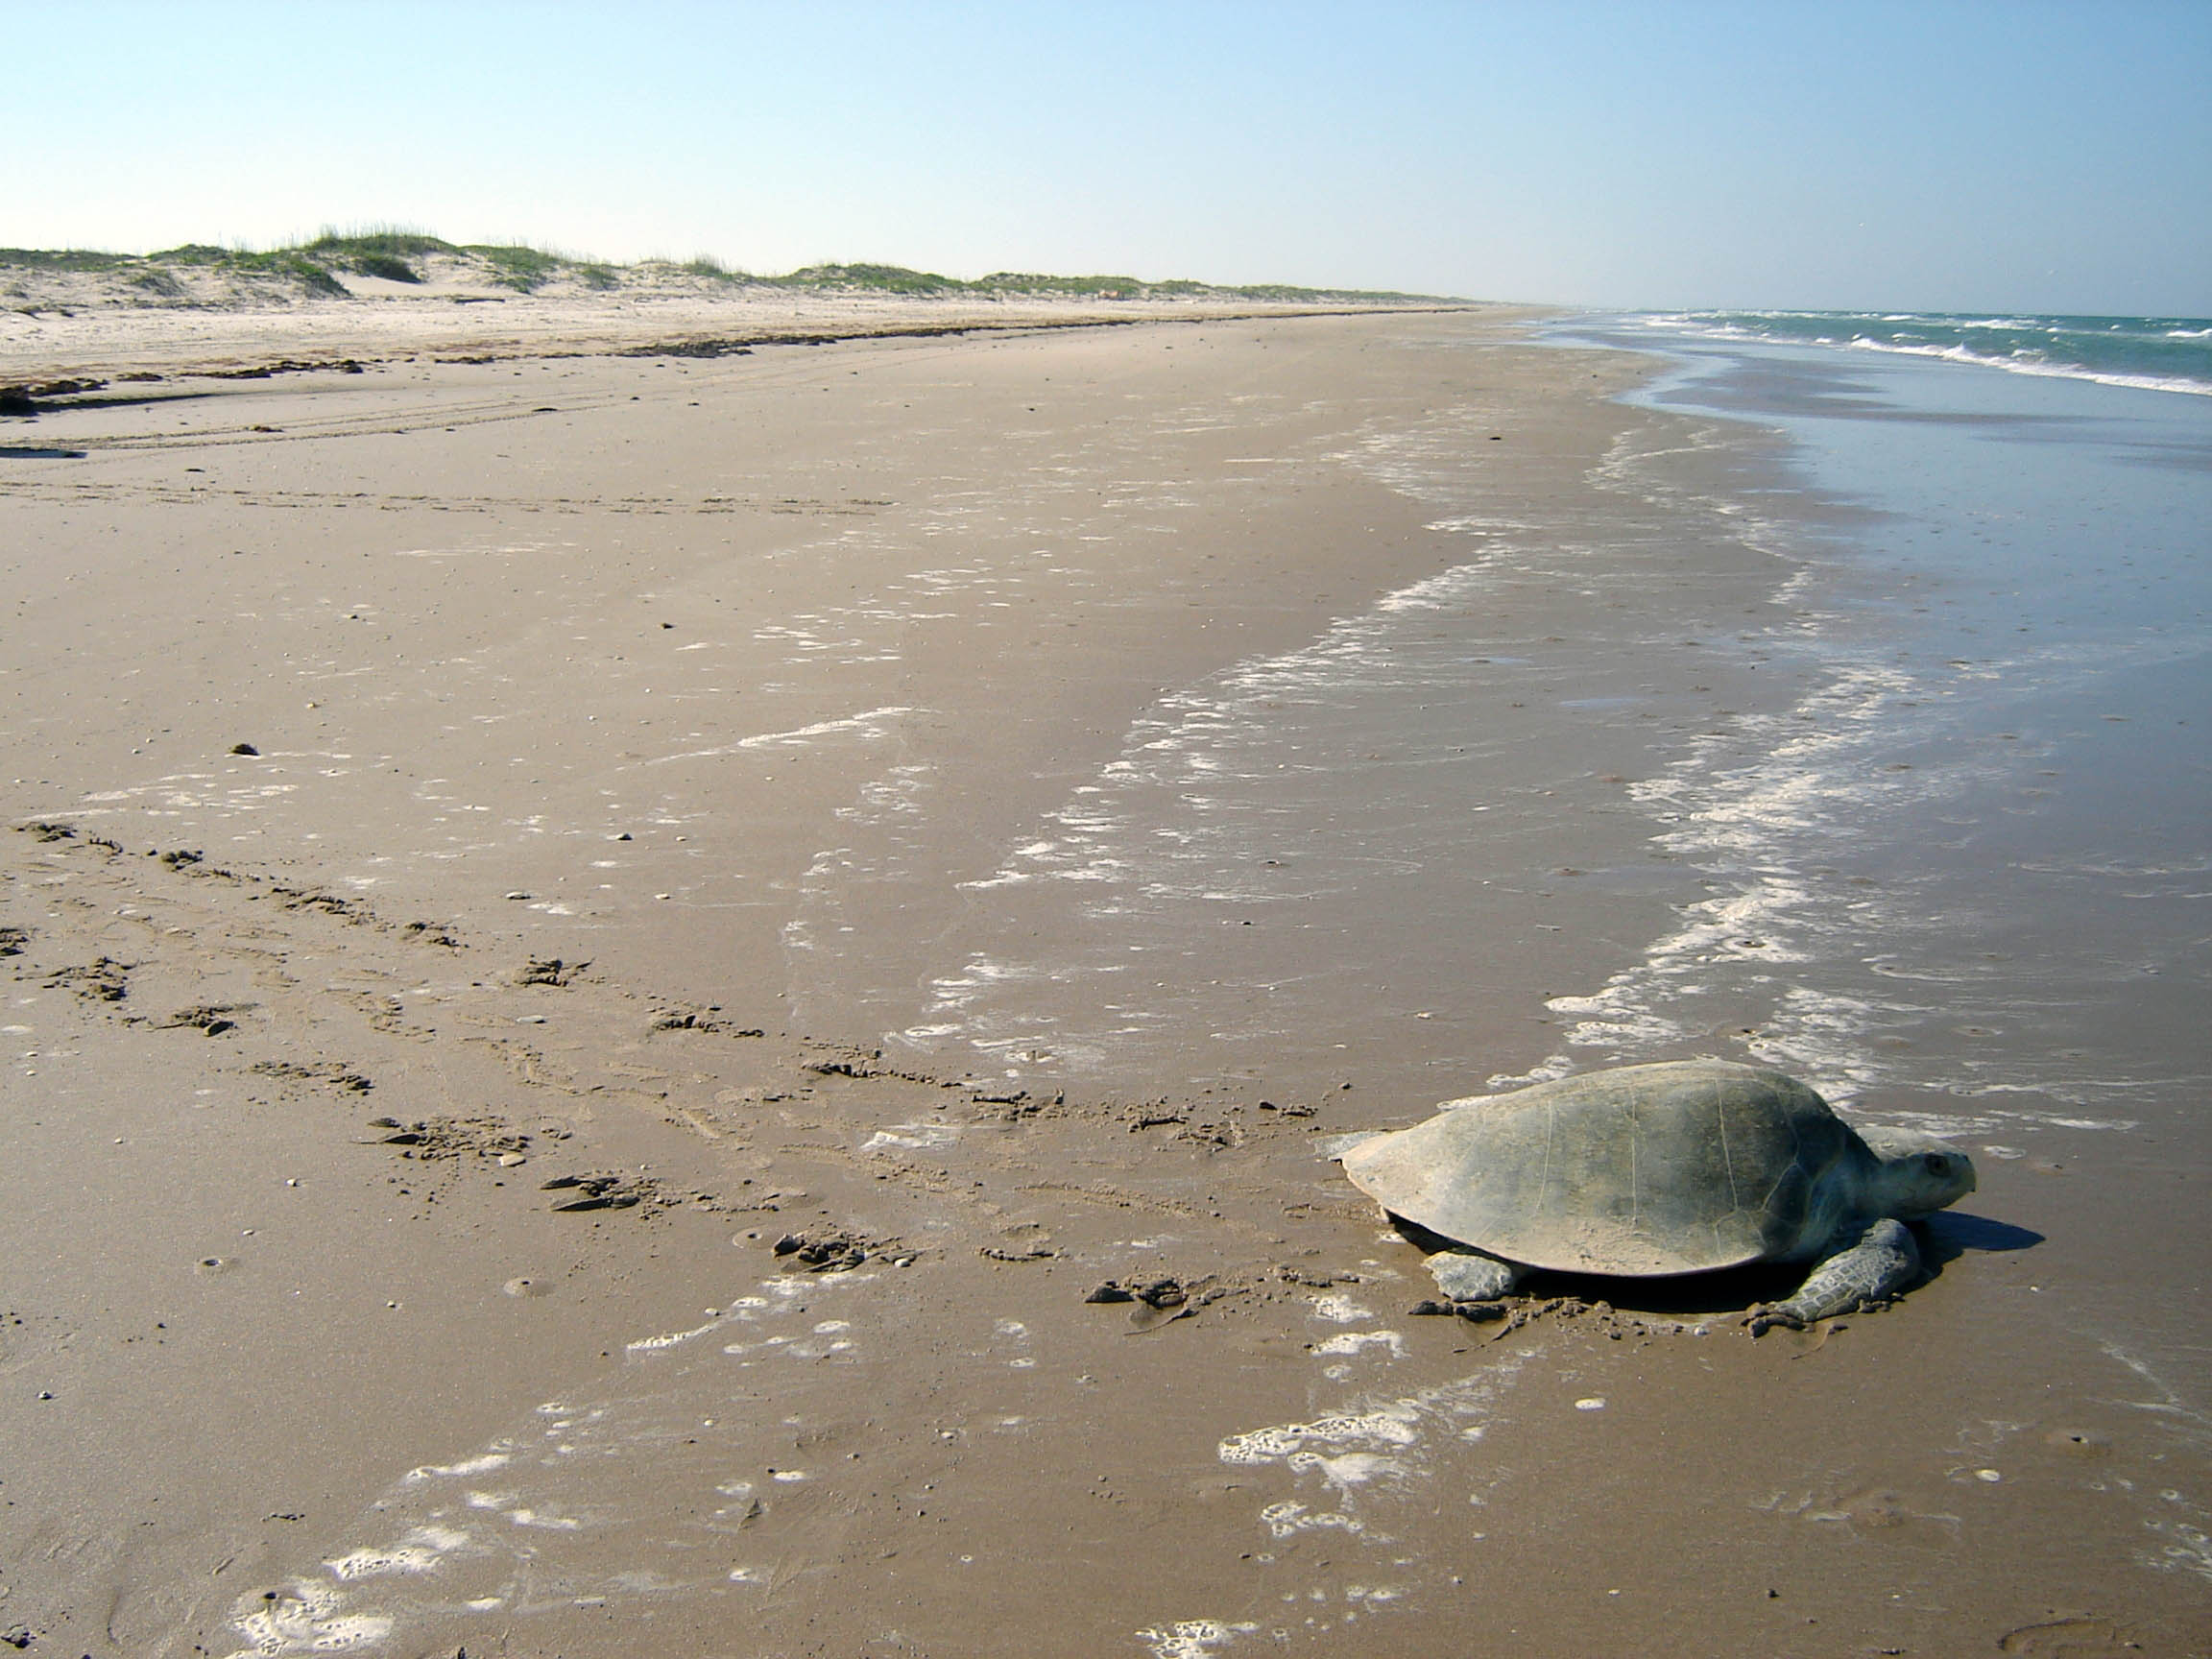
Tourism of The Southwest
Padre Island, Texas has beaches, surf fishing and native wildlife.

Slide 20
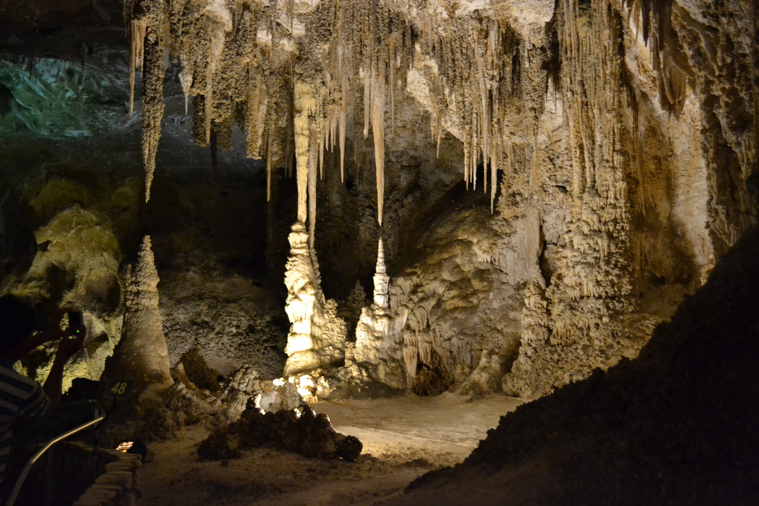
Tourism of The Southwest
Carlsbad Caverns in New Mexico.

Slide 21
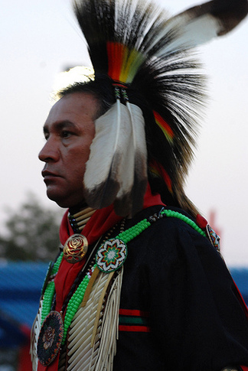
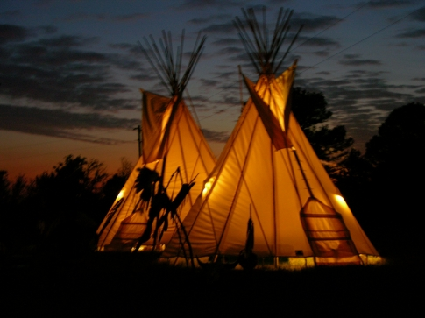
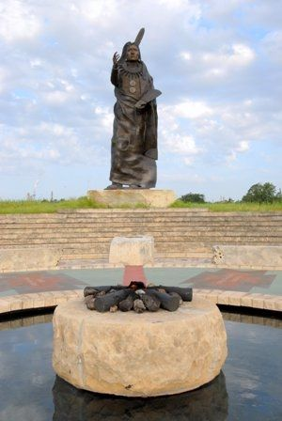
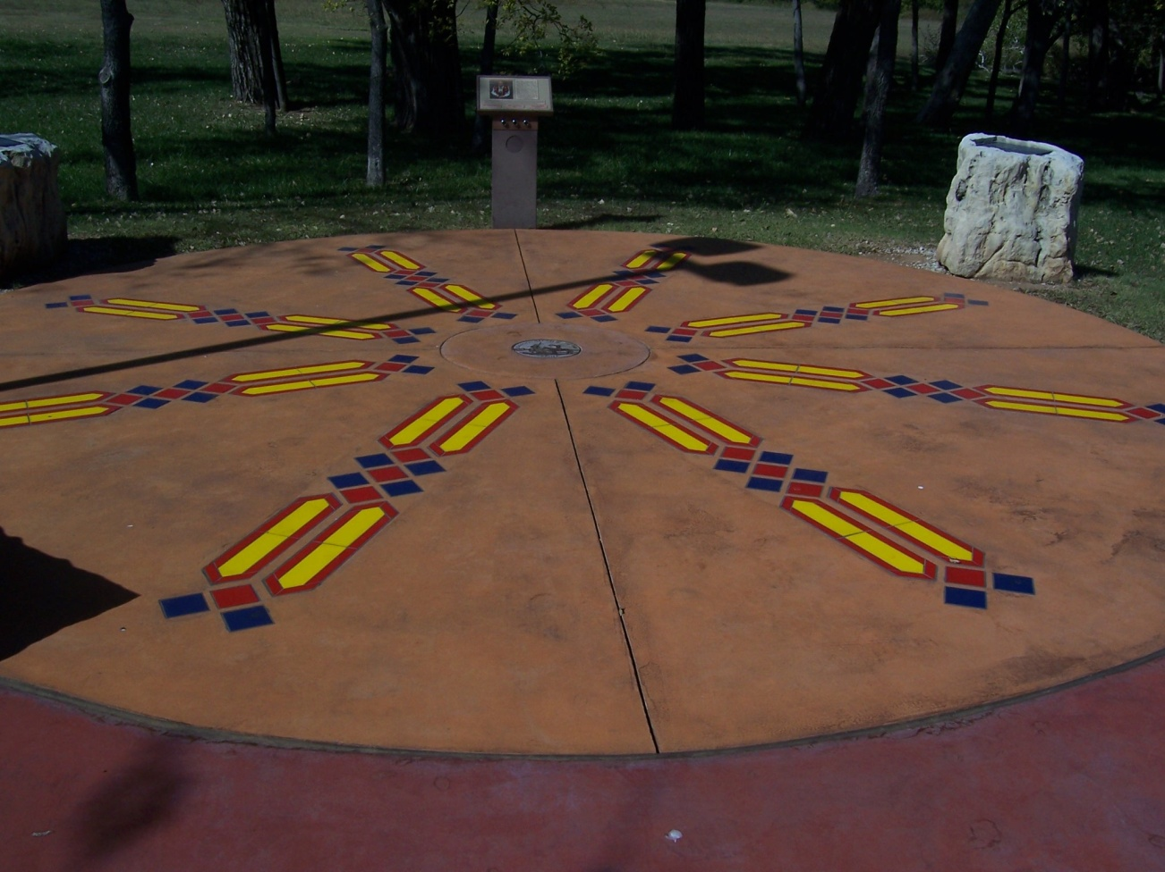
Cultural Preservation in The Southwest
Oklahoma is a center for many native American tribes. These images are from Standing Bear Native American Memorial Park in Ponca, Oklahoma.
For Native Americans dance is more than dancing.

Slide 22
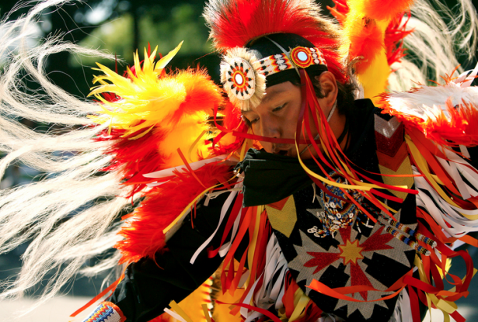
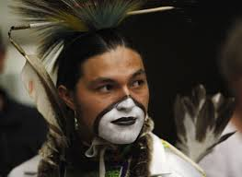
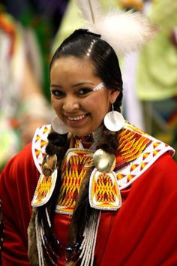
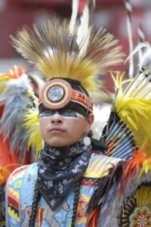
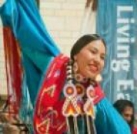
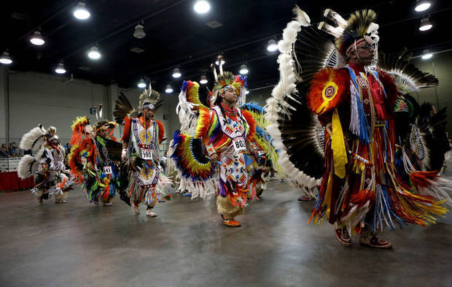
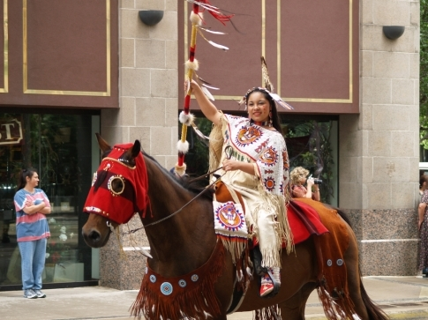
Cultural Preservation in The Southwest
The 30th Annual Red Earth Festival is June 10-12, 2016 in Oklahoma City.

Slide 23
Visiting the Southwest
Important cities in the Southwest include: Phoenix in Arizona, Dallas ~ Houston ~ Fort Worth, Texas, Oklahoma City in Oklahoma.
Tourist sites people like to visit in the Southwest include:
The population of the West is about 60 million people.

