Slide 1
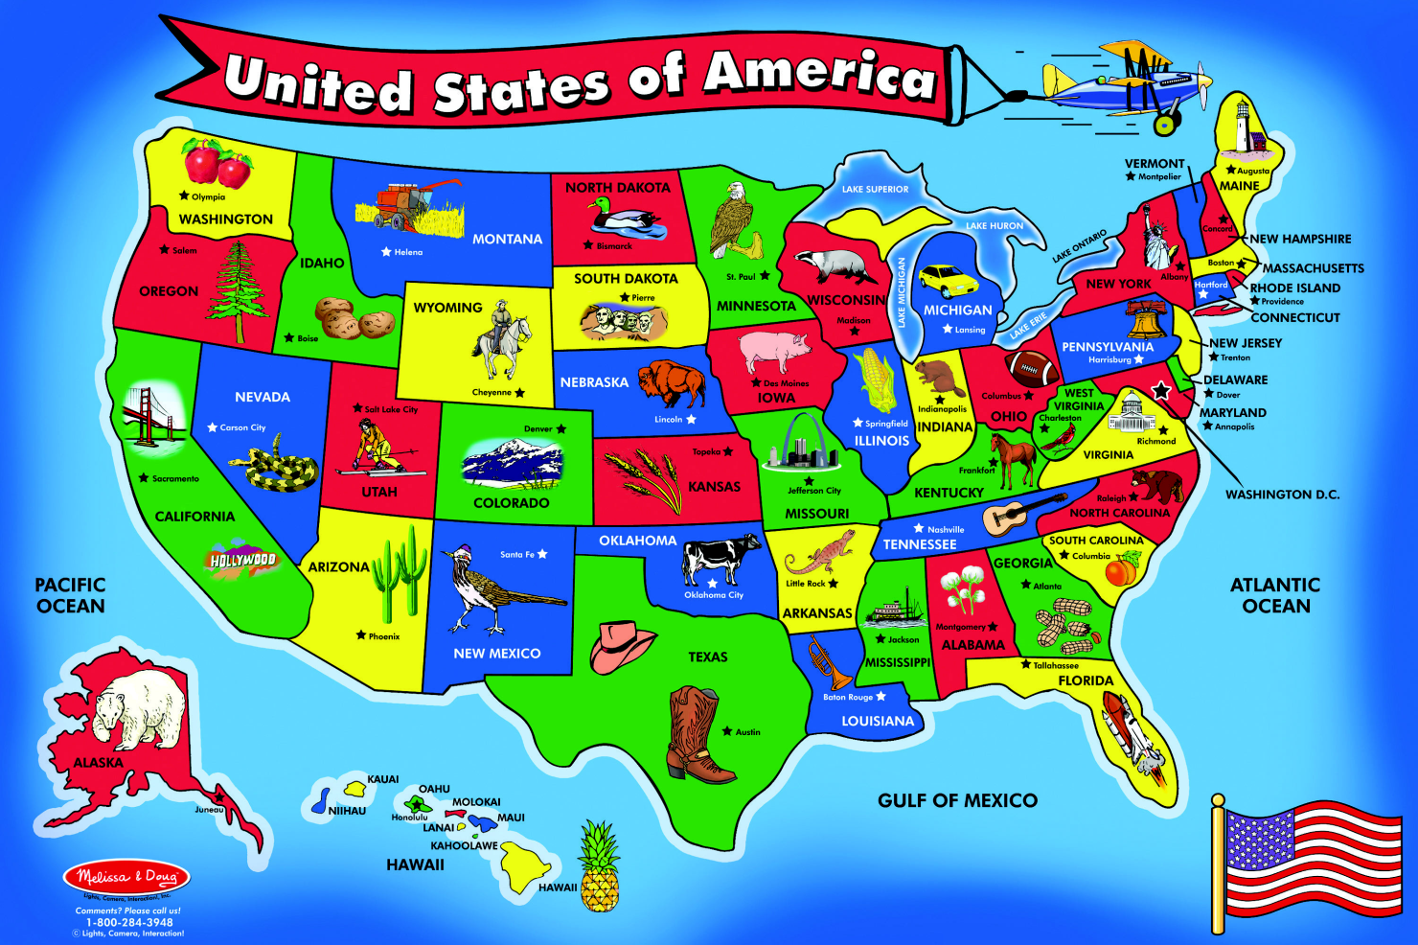
States and Regions
Of the country the United States
This image is an actual floor puzzle made by

Slide 2
Lesson Objectives
Identify the United States as a nation in North America.
Identify the different geographic, economic, and cultural characteristics of each region.
Describe the relative location of the five regions of the United States.

Slide 3
Vocabulary words to learn
Contiguous
Region
Relative location
Continent
Population
As you learn these words today record them on your note sheet.

Slide 4
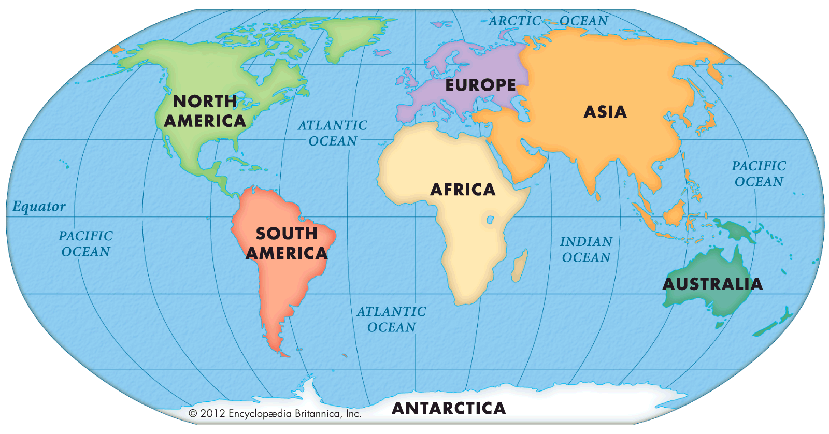
A Country in North America
The United States is located in the continent of North America. There are seven continents, or large land masses, that make up Earth.
Our continent

Slide 5
A Country in North America
The United States is one of the largest countries in North America.
You can measure the size of a country in two different ways:
land area (physical geography)
population (number of people)
In land area, Canada is the largest country in North America (USA is 2nd).
In population, the United States is the largest country in North America (Mexico is 2nd).

Slide 6
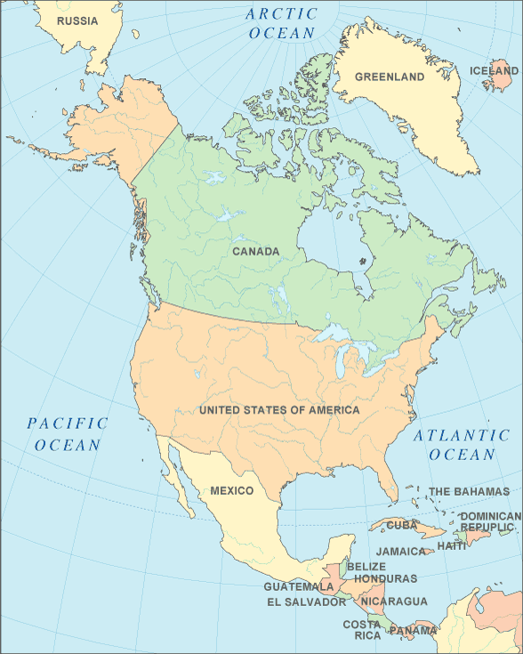
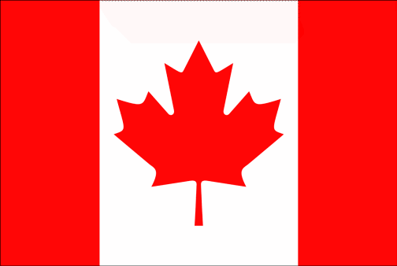
North America
The continent of North America is home to several countries, but 3 main countries.
The country with the largest land and the farthest north is Canada.
1
The country in the middle of North America is the United States – your country. The United States has the most population of the 3 countries in North America.
2
3
Mexico is the farthest south of the countries of North America.

Slide 7
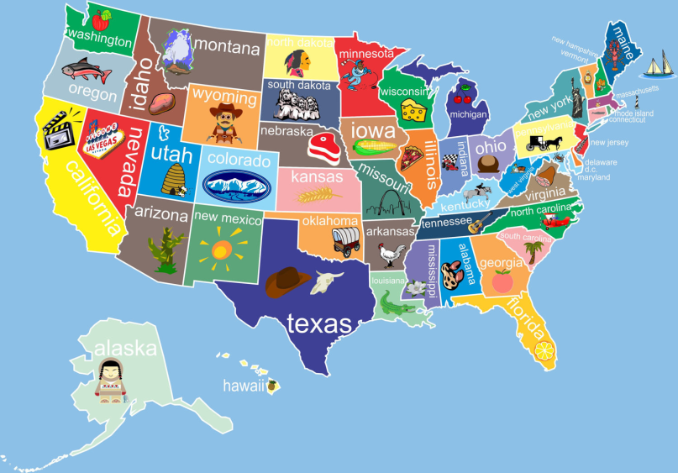
A Nation of 50 States
48 of the 50 states are contiguous, next to each other (or connected) and share at least one border with another state. The contiguous states are what you are used to seeing on a map of the United States. Complete Contiguous on your vocabulary section of notes.
Two states, Alaska and Hawaii, are separated from the other states. (so they are not included in the contiguous states)
The United States can be separated into smaller regions, areas in which many features are similar. A region is an area that has some similarities. Regions can be made by geography – land, culture, or climate – the weather patterns
The states are separated into five regions. The relative location of a place is where it is compared to other places.

Slide 8
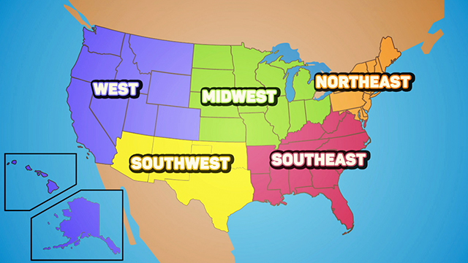
Regions of the United States

Slide 9
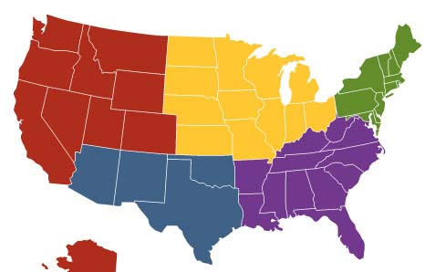
The West
The West Region is made up of the following states:
Washington
Montana
Oregon
Idaho
Northeast
Wyoming
WEST
Midwest
Nevada
California
Utah
Colorado
Southwest
Southeast

Slide 10
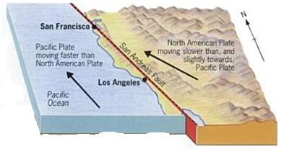
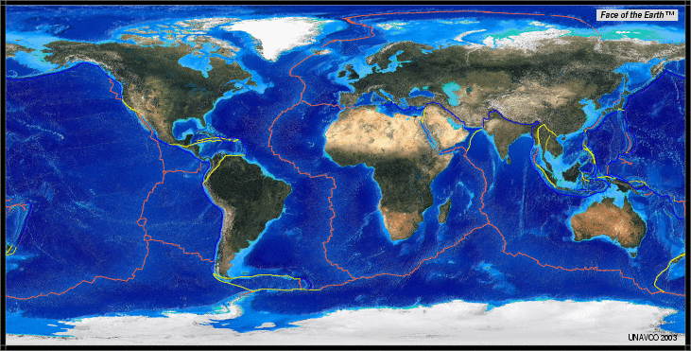
Geography of the West
The West Region includes the Rocky Mountains and the Pacific Coast. There are deserts and forests as well. The San Andreas fault is a boundary between 2 tectonic plates. These plates move frequently causing earthquakes.

Slide 11
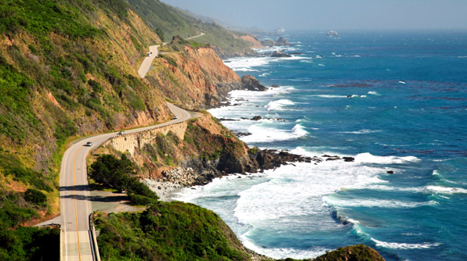
Geography of The West
Pacific Coast
Washington, Oregon, California

Slide 12
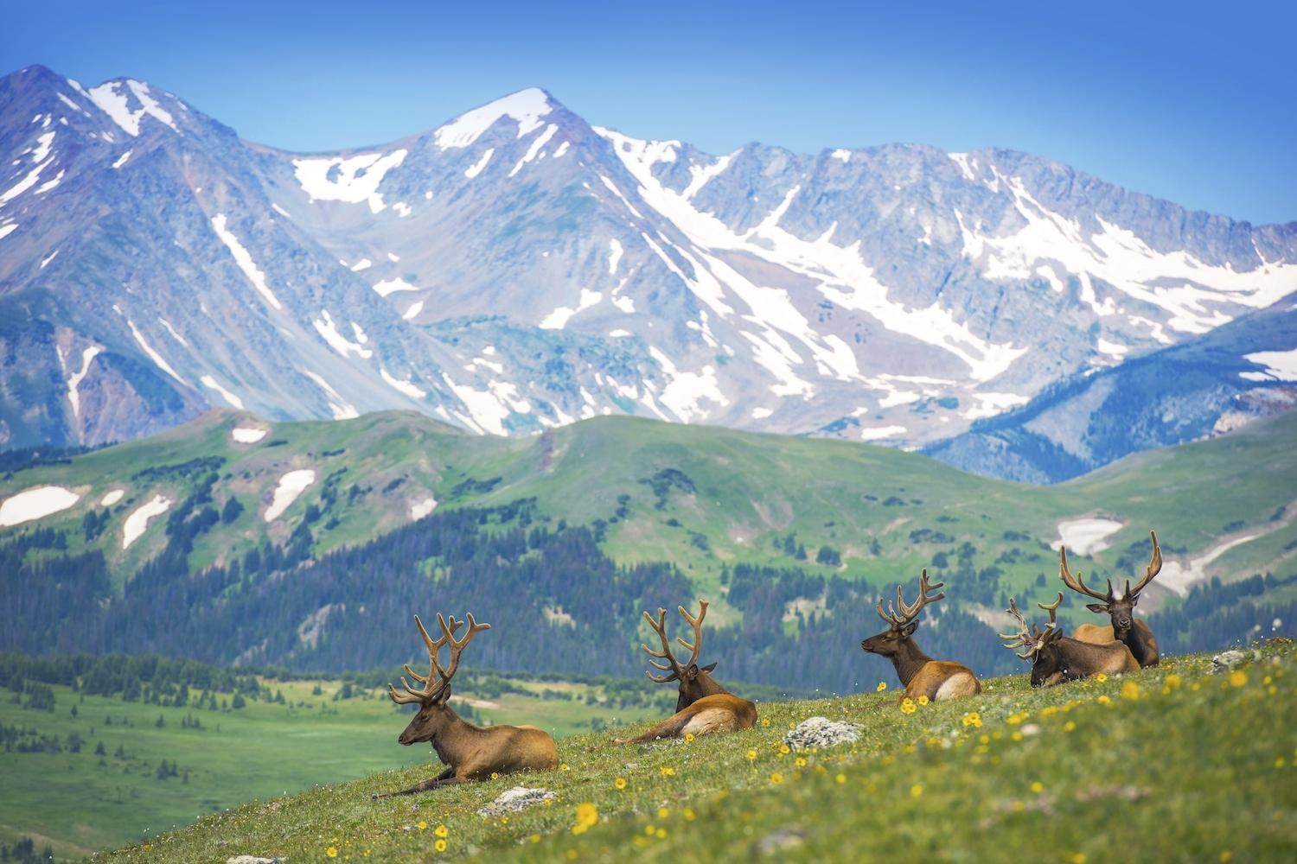
Geography of The West
Rocky Mountains
Colorado, Nevada, Utah, Idaho, Wyoming, Montana

Slide 13
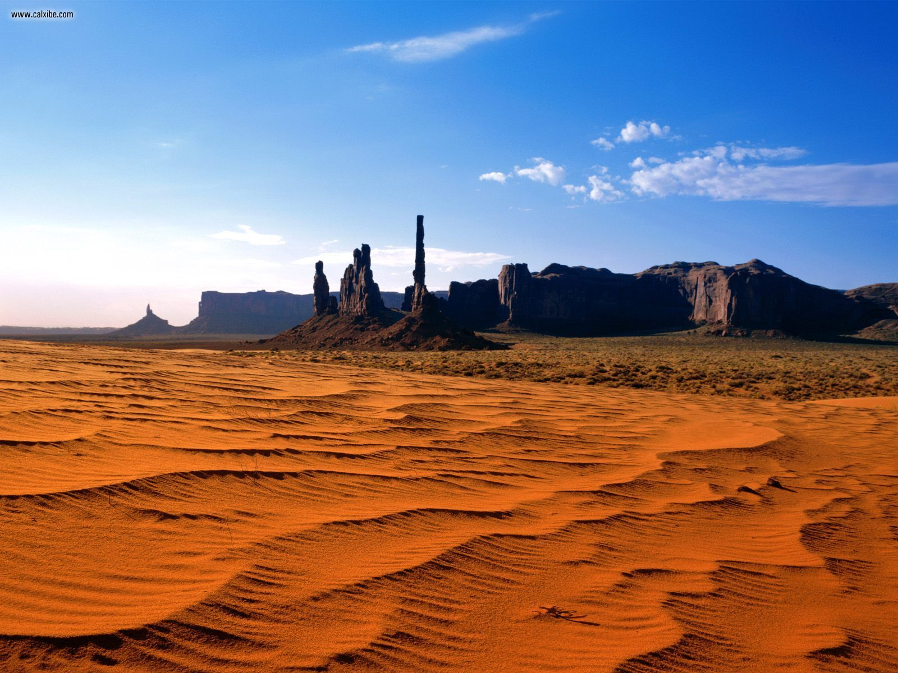
Geography of The West
Death Valley Desert
Nevada and California – hottest place in U.S.

Slide 14
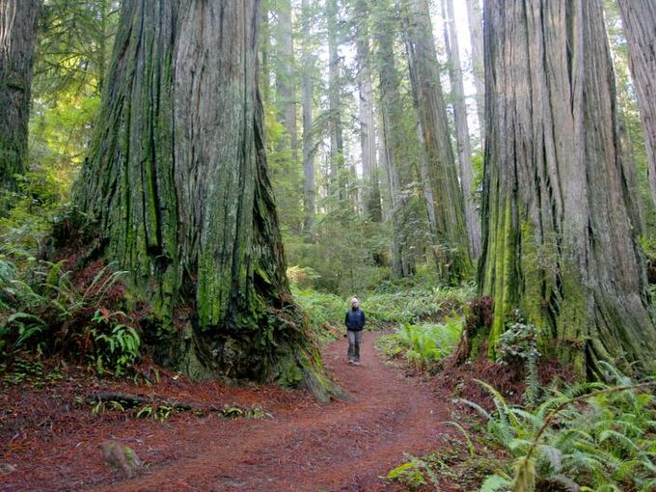
Geography of The West
Redwood Forest
California

Slide 15
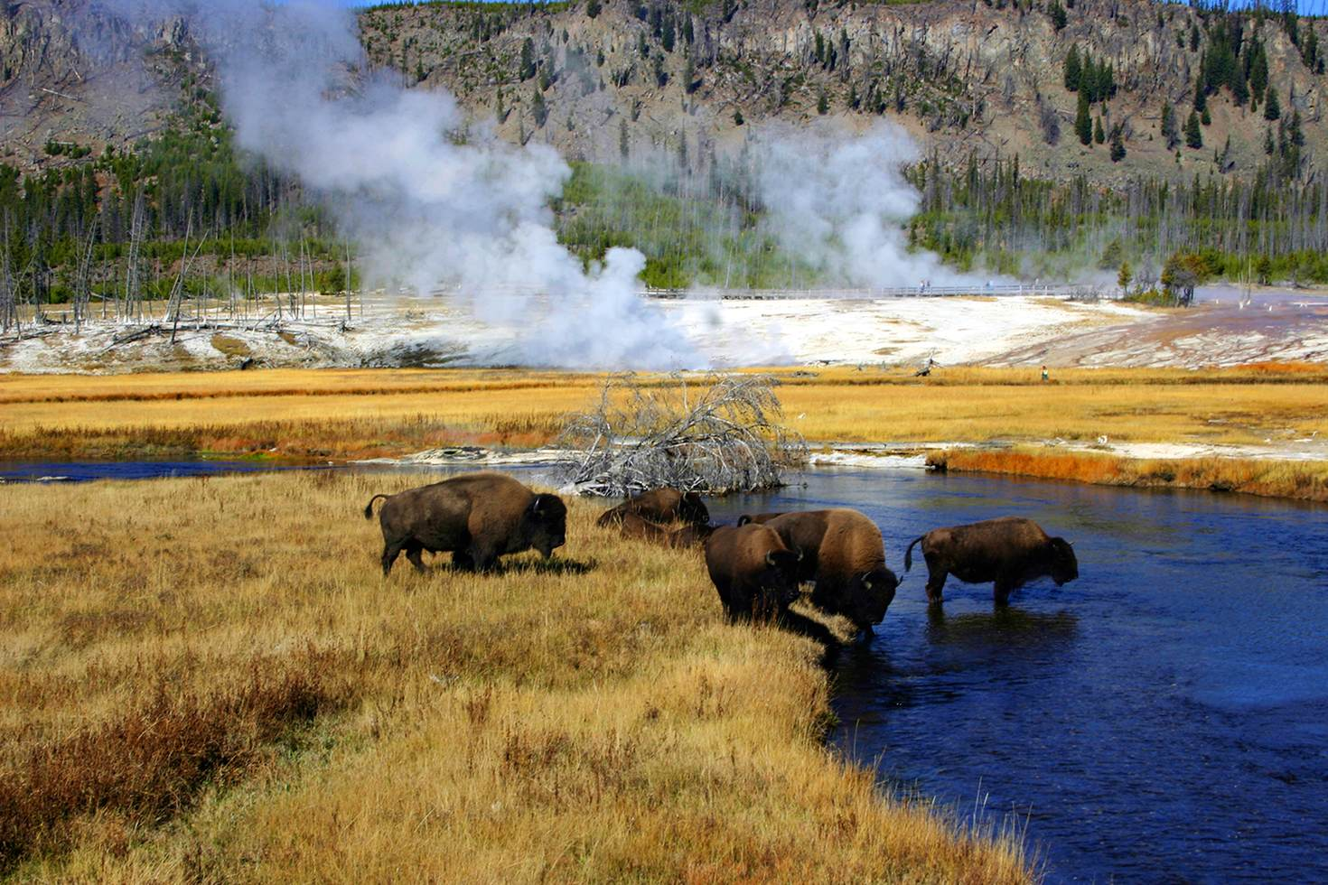
Geography of The West
Yellowstone
Idaho, Wyoming, Montana

Slide 16
Economy of the West
The West builds their economy (making money) from:
industry (making things like cars or computers),
agriculture (farming, wineries)
ranching (raising cattle),
mining.
and tourism.

Slide 17
Industry of The West
Building computers in Silicon Valley
Colorado, Nevada, Utah, Idaho, Wyoming, Montana

Slide 18
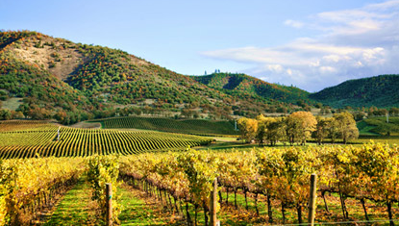
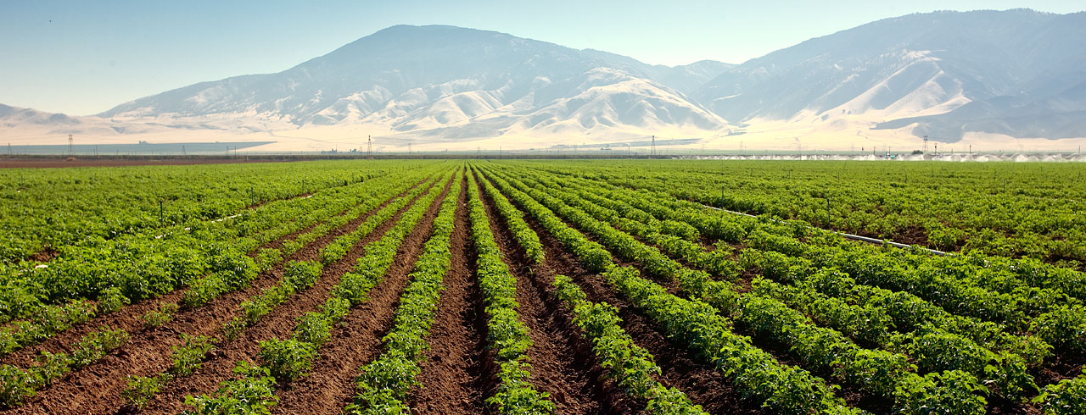
Agriculture of The West
A vineyard in California wine country
A potato farm in Idaho
Colorado, Nevada, Utah, Idaho, Wyoming, Montana

Slide 19
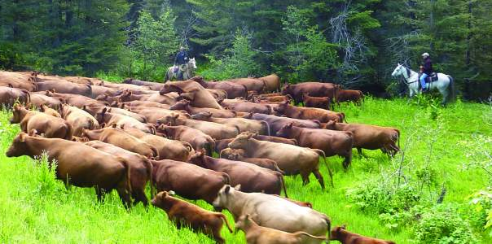
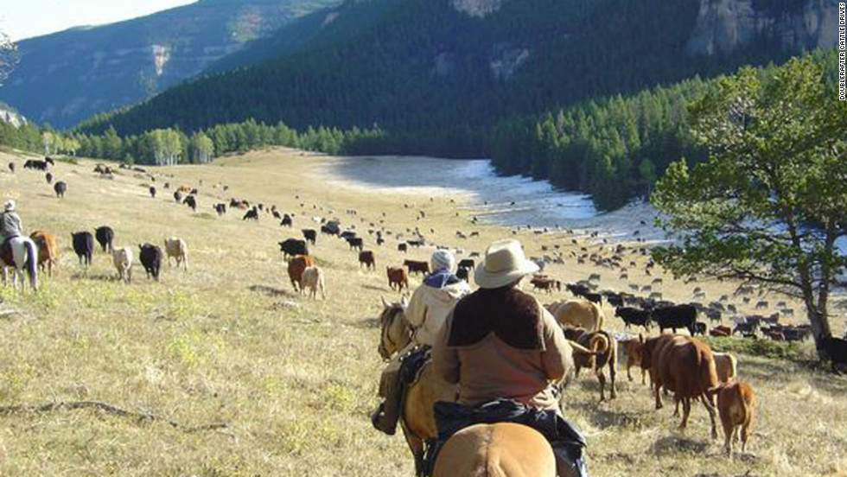
Ranching in The West
A family ranch in Montana
Driving cattle in Wyoming
Colorado, Nevada, Utah, Idaho, Wyoming, Montana

Slide 20
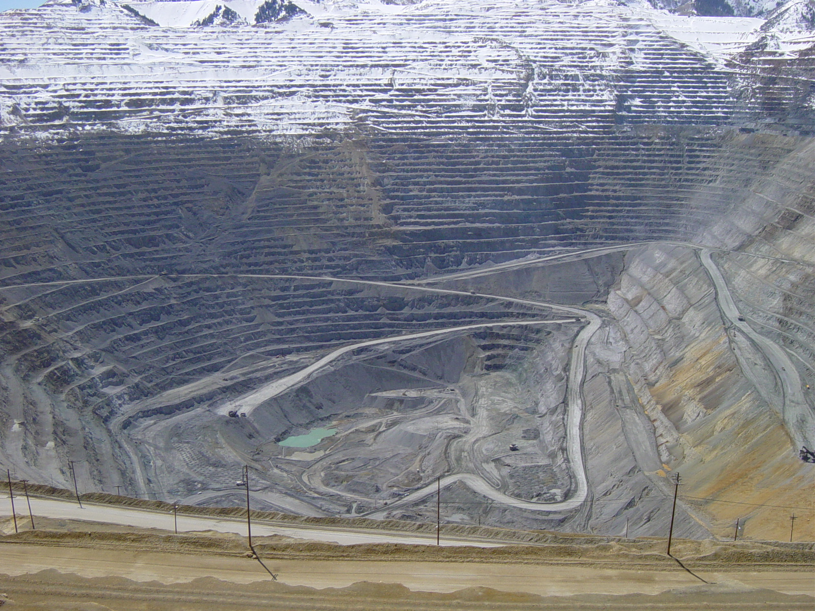
Mining in The West
A copper mine in Utah
Colorado, Nevada, Utah, Idaho, Wyoming, Montana

Slide 21
Visiting the West
Important cities in the West include Denver in Colorado, Los Angeles and San Francisco in California, Seattle in Washington, Salt Lake City in Utah, and Las Vegas in Nevada.
Tourist sites people like to visit in the West include: the Hollywood Walk of Fame, Yellowstone National Park, the Golden Gate Bridge, Disneyland, Universal Studios, Death Valley National Park, Redwood National Park.
The population of the West is about 60 million people.

Slide 22
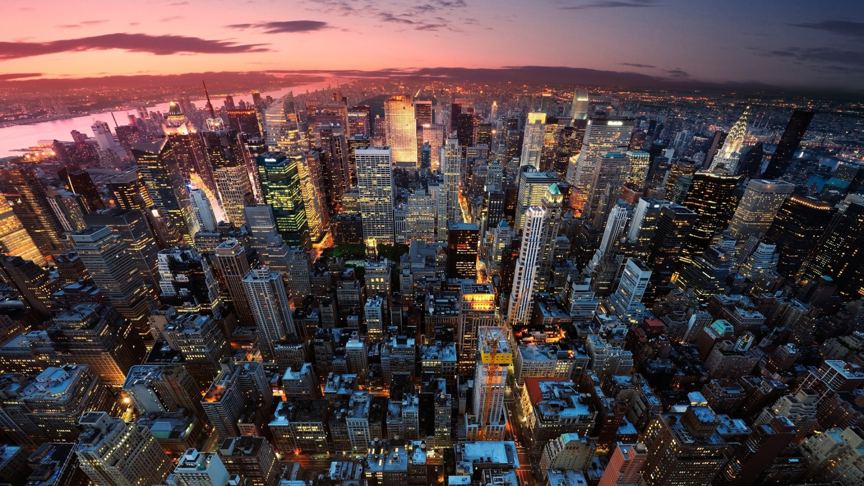
Points of Interest and Tourism in The West
Los Angeles, California
California

Slide 23
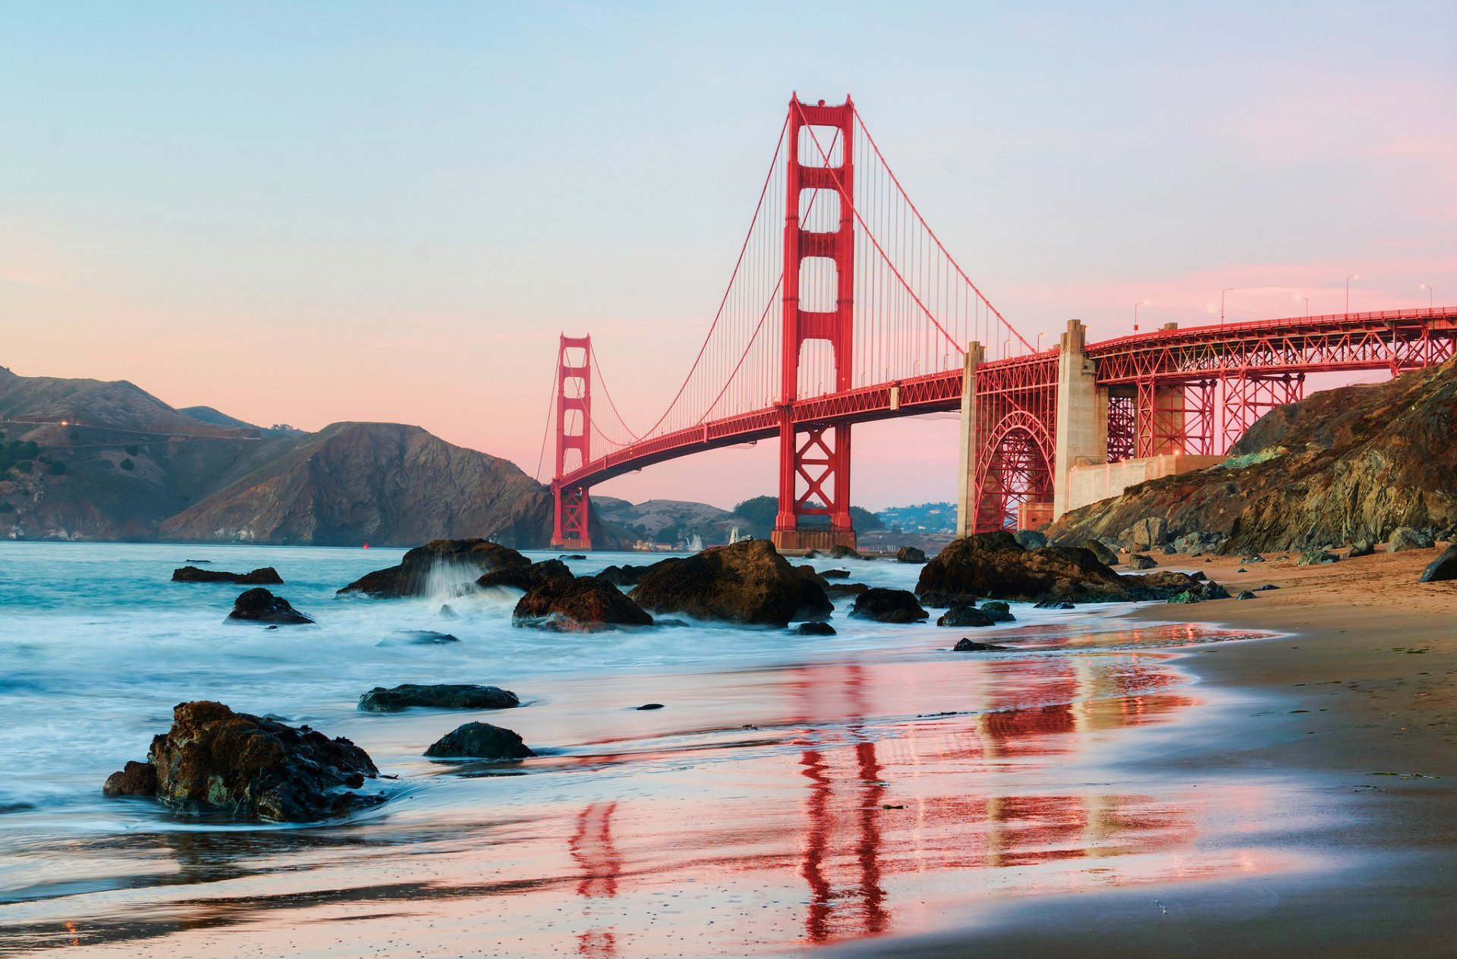
Points of Interest and Tourism in The West
Golden Gate Bridge
San Francisco, California

Slide 24
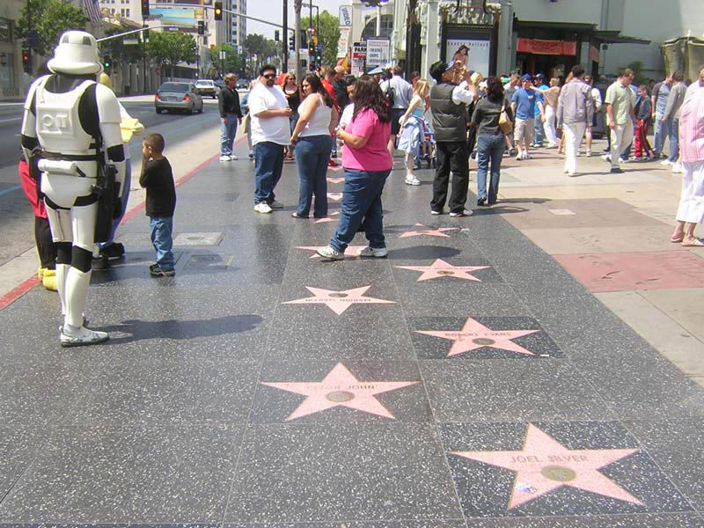
Points of Interest and Tourism in The West
Hollywood Walk of Fame
Los Angeles, California

Slide 25
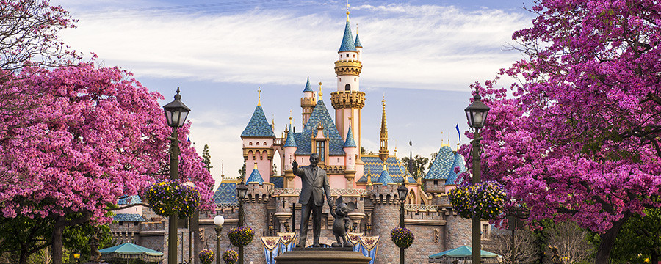
Points of Interest and Tourism in The West
Disneyland
Los Angeles, California
Anaheim, California

