Slide 1
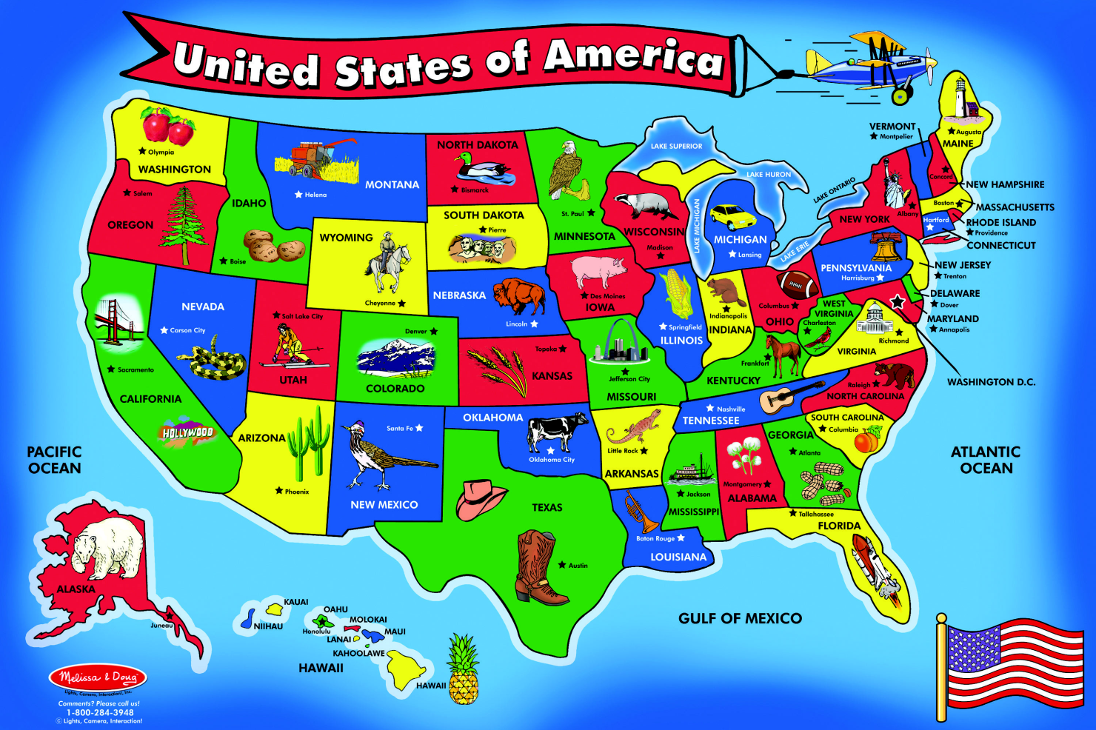
States and Regions
Of the country the United States
This image is an actual floor puzzle made by

Slide 2
Lesson Objectives
Identify the United States as a nation in North America.
Identify the different geographic, economic, and cultural characteristics of each region.
Describe the relative location of the five regions of the United States.

Slide 3
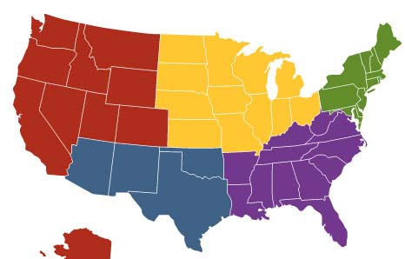
The Midwest
The Midwest Region is made up of the following states:
North Dakota
Minnesota
Wisconsin
South Dakota
MIDWEST
Michigan
Northeast
West
Iowa
Nebraska
Indiana
Ohio
Illinois
Kansas
Missouri
Southwest
Southeast

Slide 4
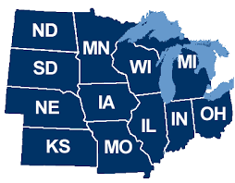
About the Midwest ~ Land and People
The Midwest has many diverse areas from the open land of the Dakotas to the farm land of Missouri, Iowa, and Illinois. Distinct pockets of culture are in the Ozark Mountains and northern Lake Area states. In each area the land is beautiful in its own way and the people there have adapted to what the land has to offer.
Minnesota
North Dakota
Wisconsin
South Dakota
Michigan
Iowa
Illinois
Nebraska
Missouri
Ohio
Indiana
Kansas

Slide 5
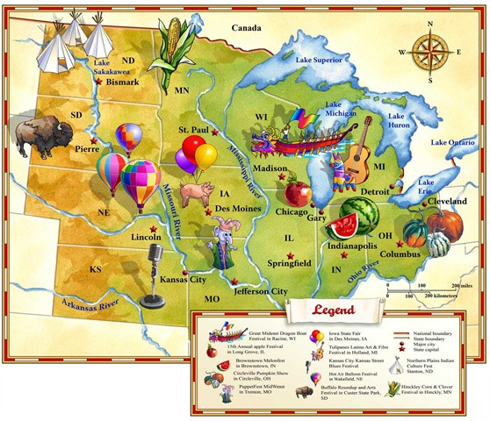
About the Midwest
The Midwest Region includes:
the Great Lakes
the Ozark Mountains
the Great Plains
the Badlands
the Black Hills
and the Mississippi River

Slide 6
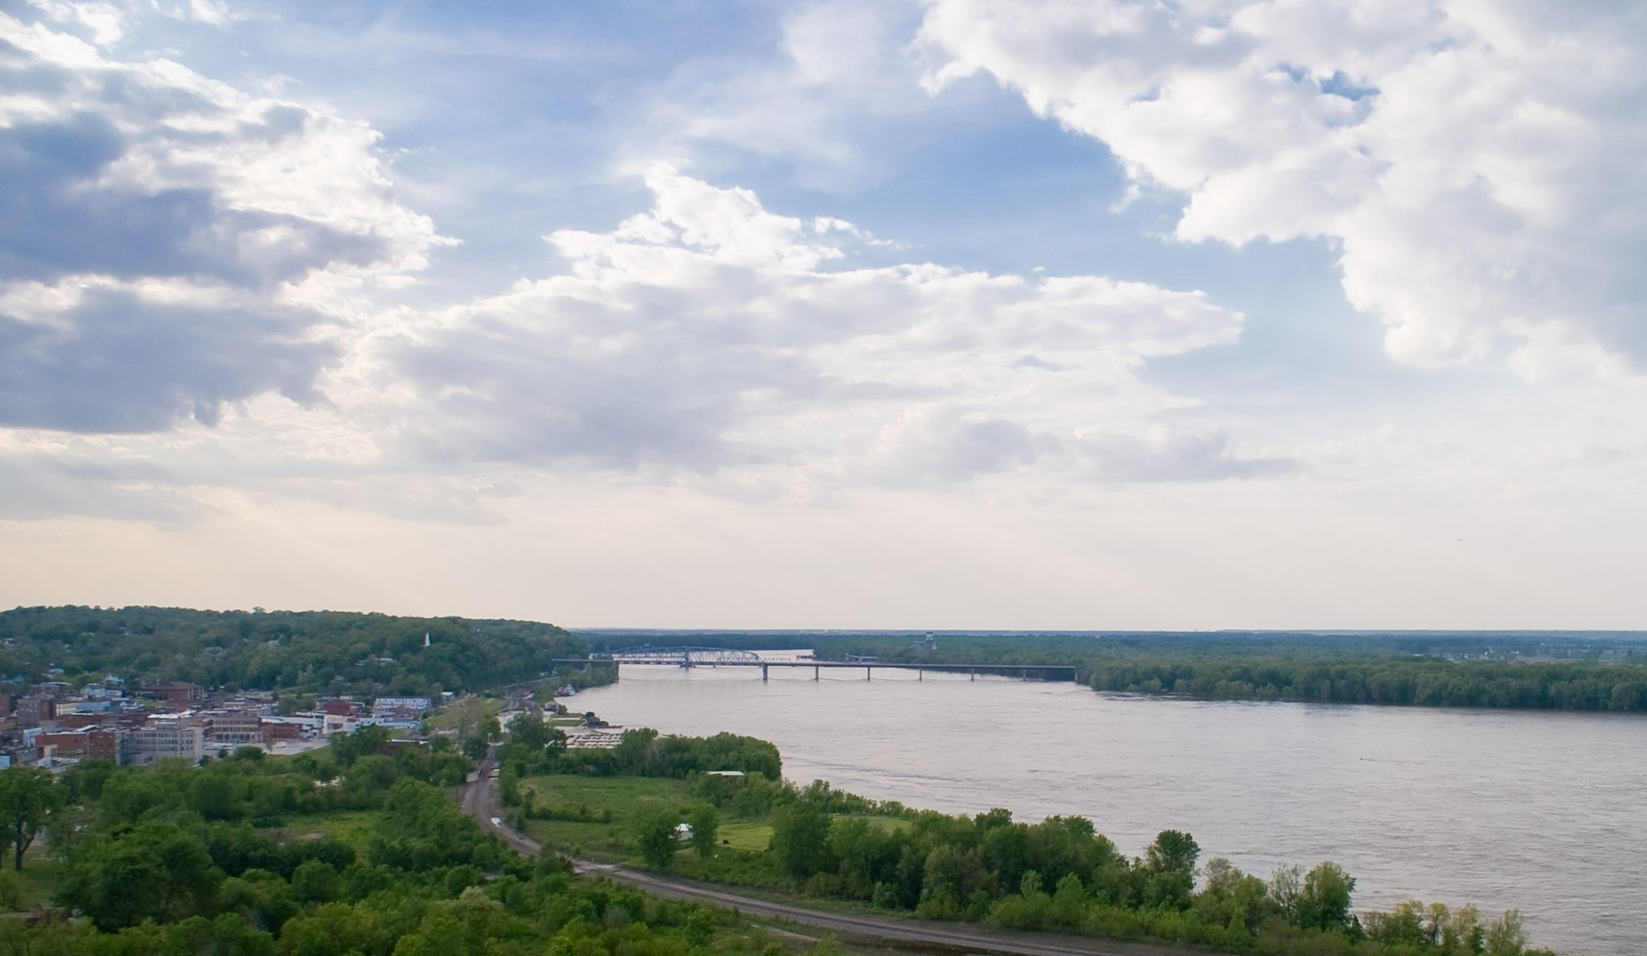
Geography of The Midwest
Mississippi River
Mississippi River
Missouri
Illinois
Hannibal, Missouri on the Missouri side looking up river on the Mississippi River.

Slide 7
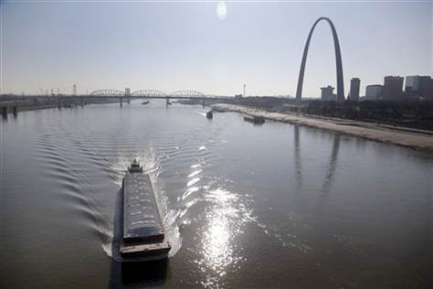
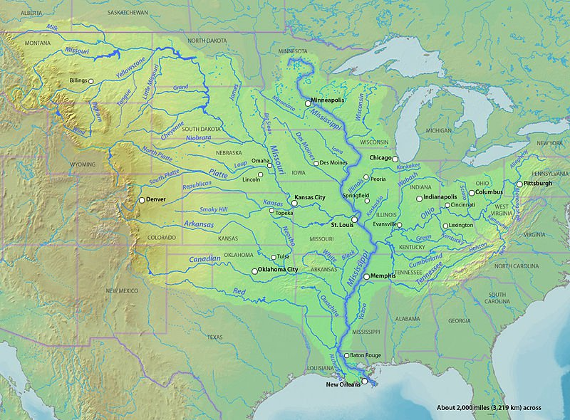
Geography of The Midwest
Barges move cargo, often grains from farms up and down the Mississippi River.
Mississippi River
Most rivers WEST of the APPALACHIAN mountains and EAST of the ROCKY mountains flow in to the MISSISSIPPI river.

Slide 8
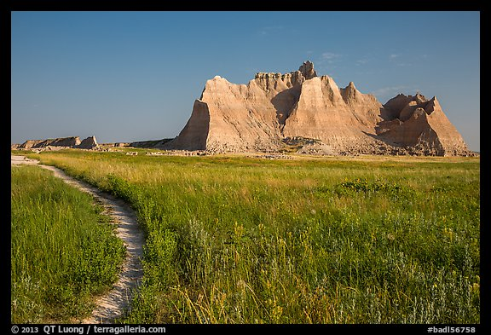
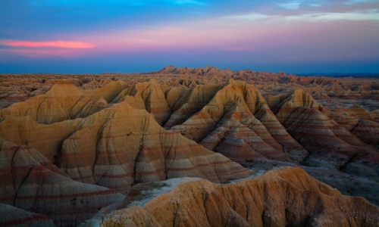
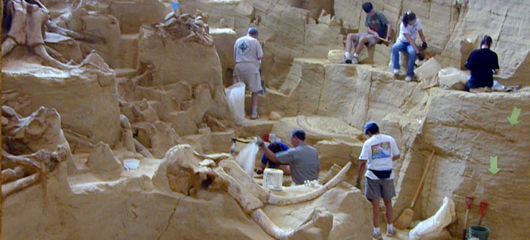
Geography of The Midwest
Badlands
Badlands National Park, South Dakota

Slide 9
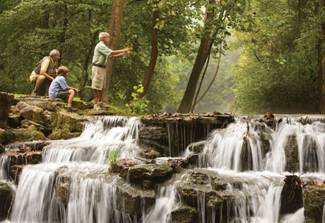
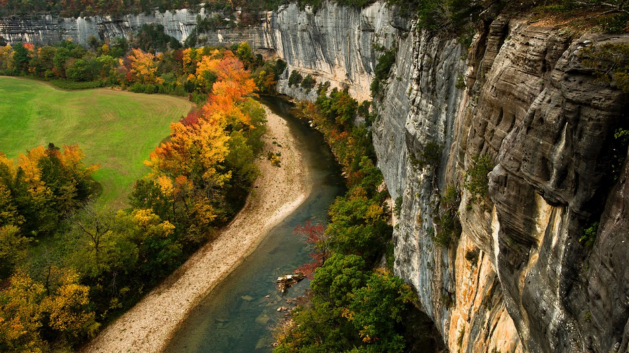
Geography of The Midwest
Ozarks
The Ozarks are a series of several physical features including: low mountains, hills, rivers, caves, and lakes. These are scattered over Oklahoma, Missouri, and Arkansas. People in these areas enjoy the many outdoor recreational activities available to them.

Slide 10
Economy of the Midwest
Agriculture –this footage all taken by drones!
and farming in the countryside
and industry in the cities contribute to the economy.
The Mississippi River and its major tributaries, the Missouri and Ohio Rivers, are important trade routes.
The population of the Midwest Region is about 66 million people.

Slide 11
Cities of the Midwest
These are the top 15 cities of the midwest. Enjoy!
LINK HERE

Slide 12
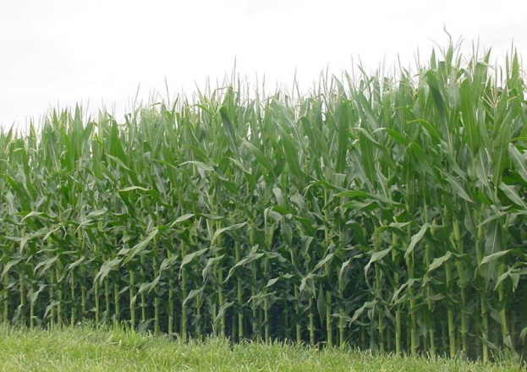
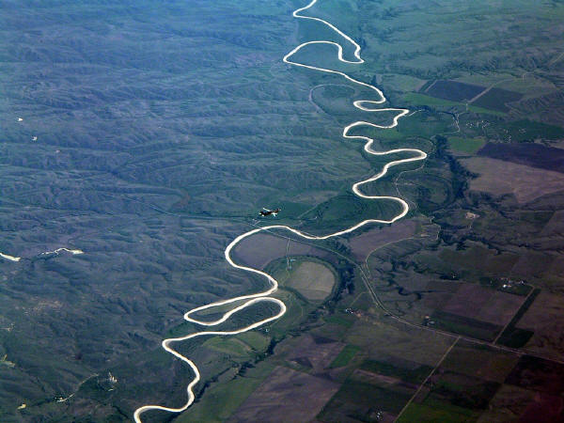
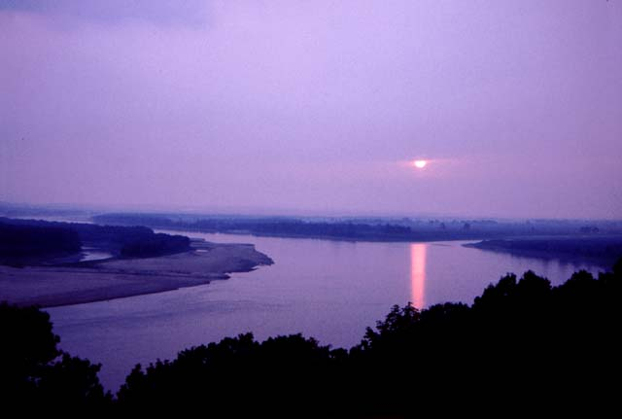
The Midwest
Corn
Mississippi
River

